Slide 1

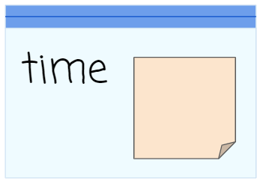
Unit 4 Lesson 5 - Activity
Can I go to the movies? I’m allowed to if it’s before 8 o’clock.
It’s 9 o’clock. Can I go to the movies?
9
Assign 9 to the variable time
Comparison operator alert!
Stop and evaluate the Boolean expression.
false
time < 8
9
true
false
I can go to the movies! 😊
I can’t go to the movies. 😞

