Slide 1

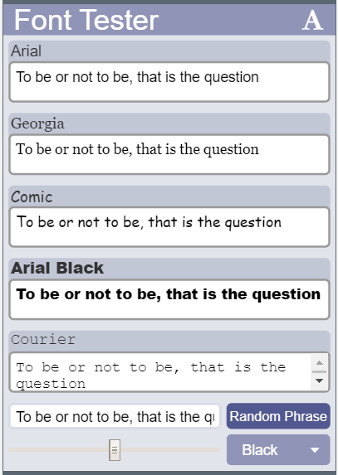
Unit 5 Lesson 6 - Activity
Do This:
With a partner
Navigate to Level 3
Run the app

