Slide 1

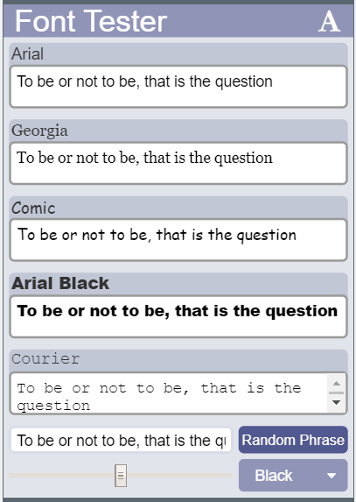
Unit 5 Lesson 6 - Activity
Discuss:
Find four different for loops in the program. What do they each do?

