Slide 1

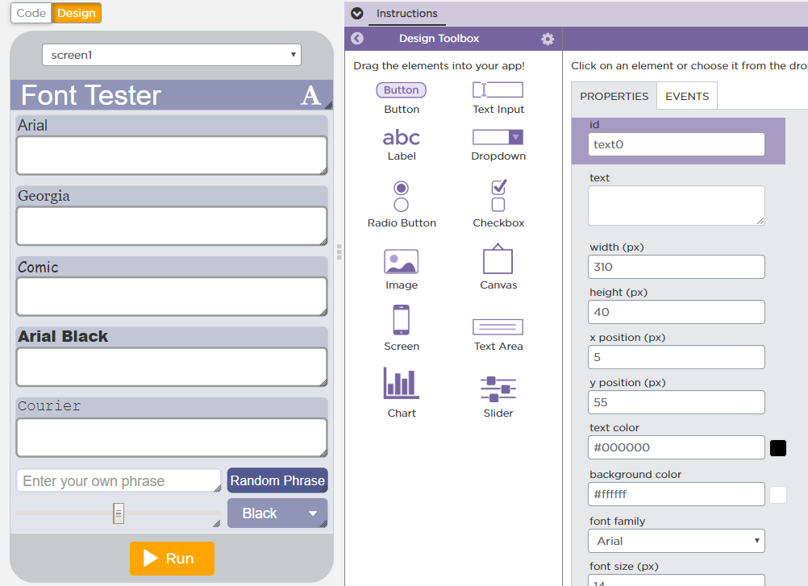
Unit 5 Lesson 6 - Activity
Do This:
Take a look at the names of the screen elements in Design Mode.
Navigate back to the code. How is "text" + i used?
How does it evaluate with each round of the loop?

