Slide 1

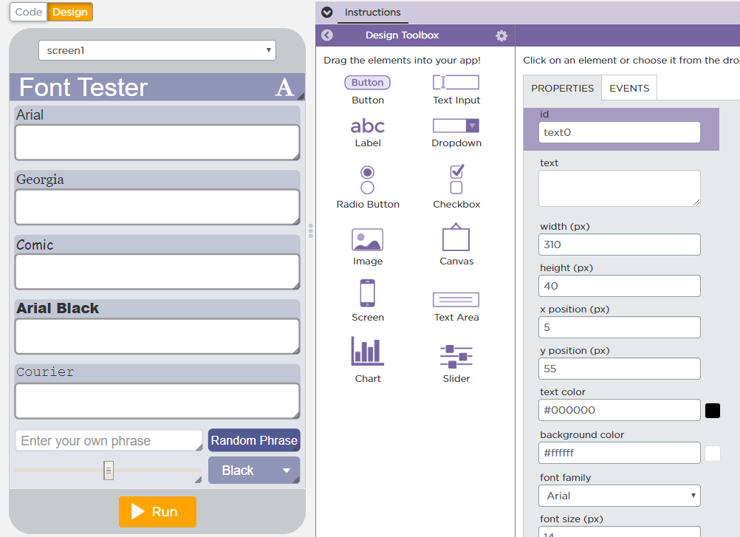
Unit 5 Lesson 6 - Activity
Do This:
What happens if you change the text box variable names?
Try changing them from text0, text1, etc. to textbox0, textbox1.
Navigate back to the code. What do you need to change in the code for the program to still work?

