Slide 1

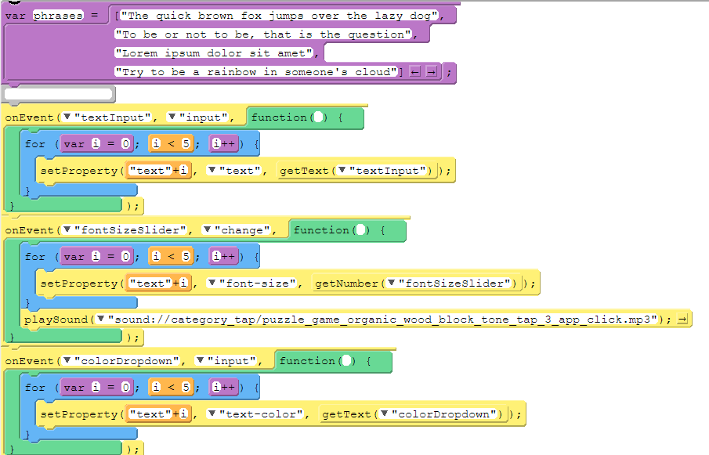
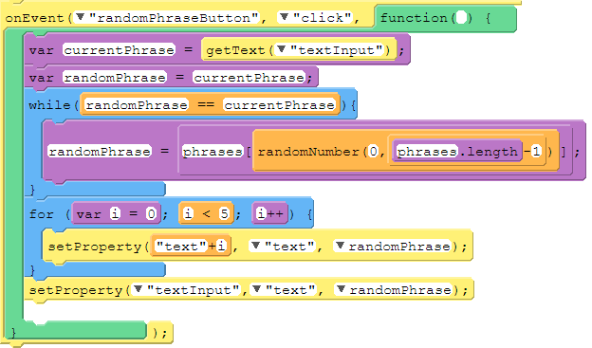
Unit 5 Lesson 6 - Activity
Do This:
What happens if you change the Boolean expression i < 5 in the for loops?
Change all the Boolean expressions to one of the options below, run the program, and discuss. Then move on to the next option and repeat:
i < 4
i < 3
i <= 4

