Slide 1
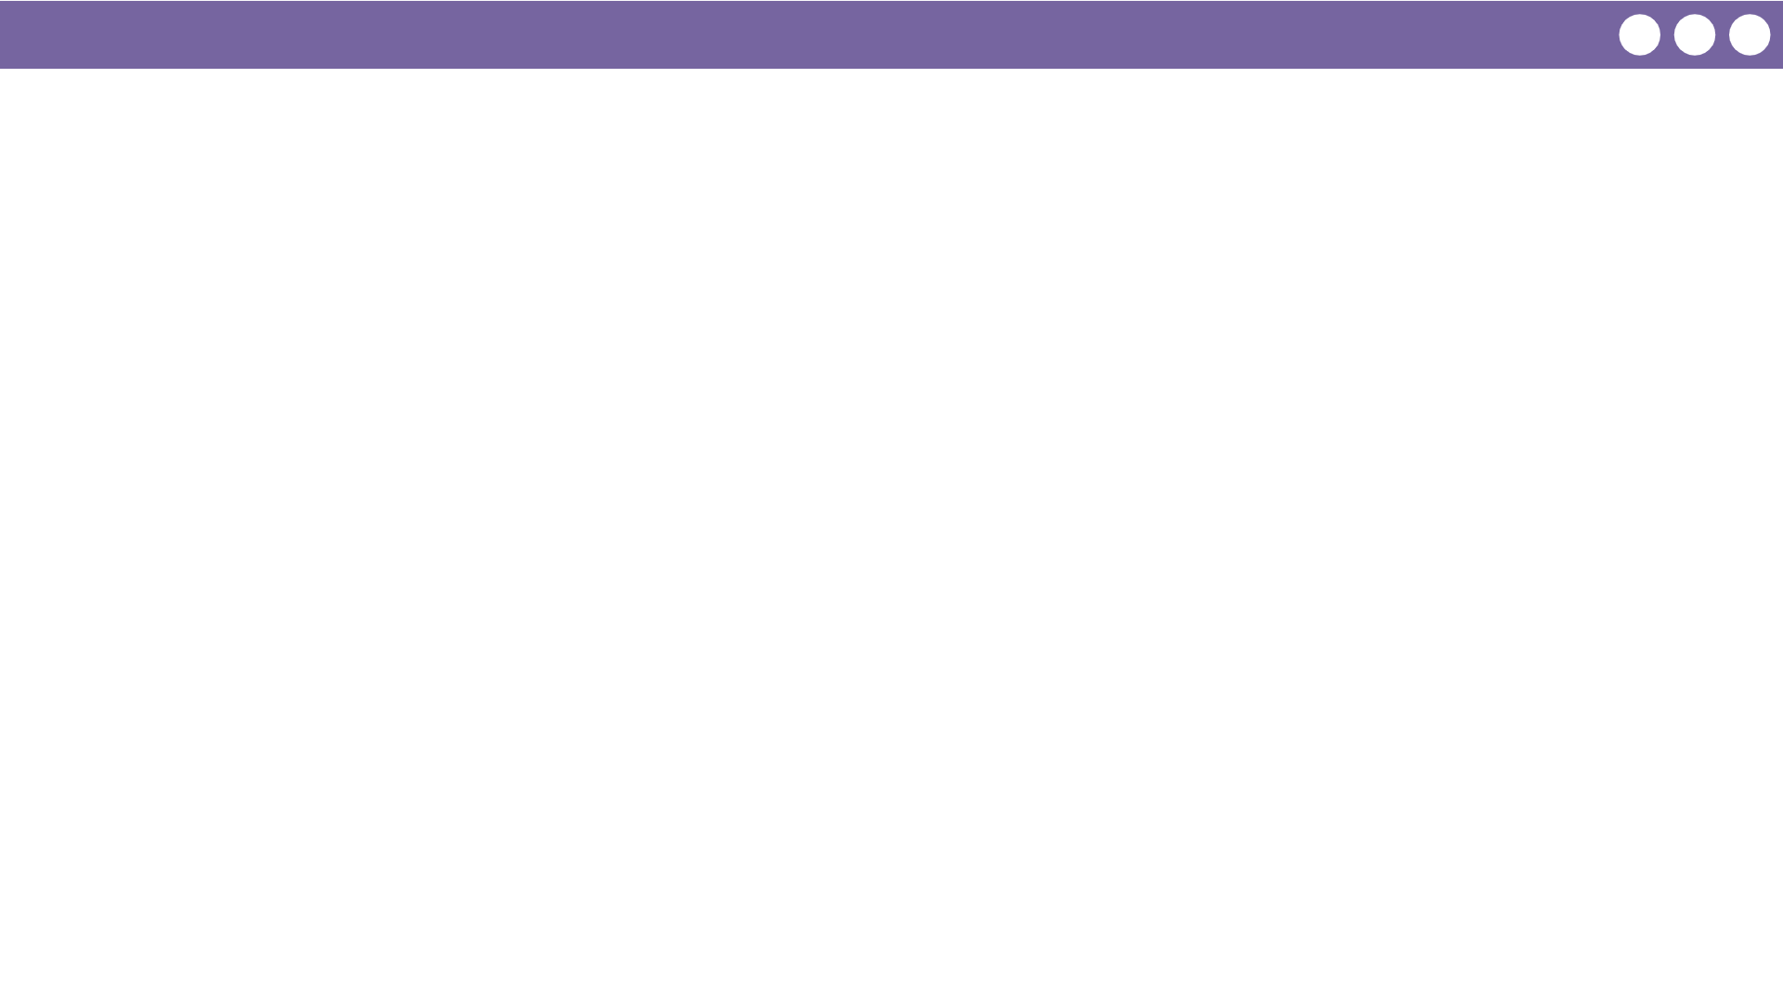
Unit 5 Lesson 6 - Wrap Up
Prompt:
What aspects of working with for loops do you feel clicked today?
What do you still feel like you have trouble with?

