Slide 1

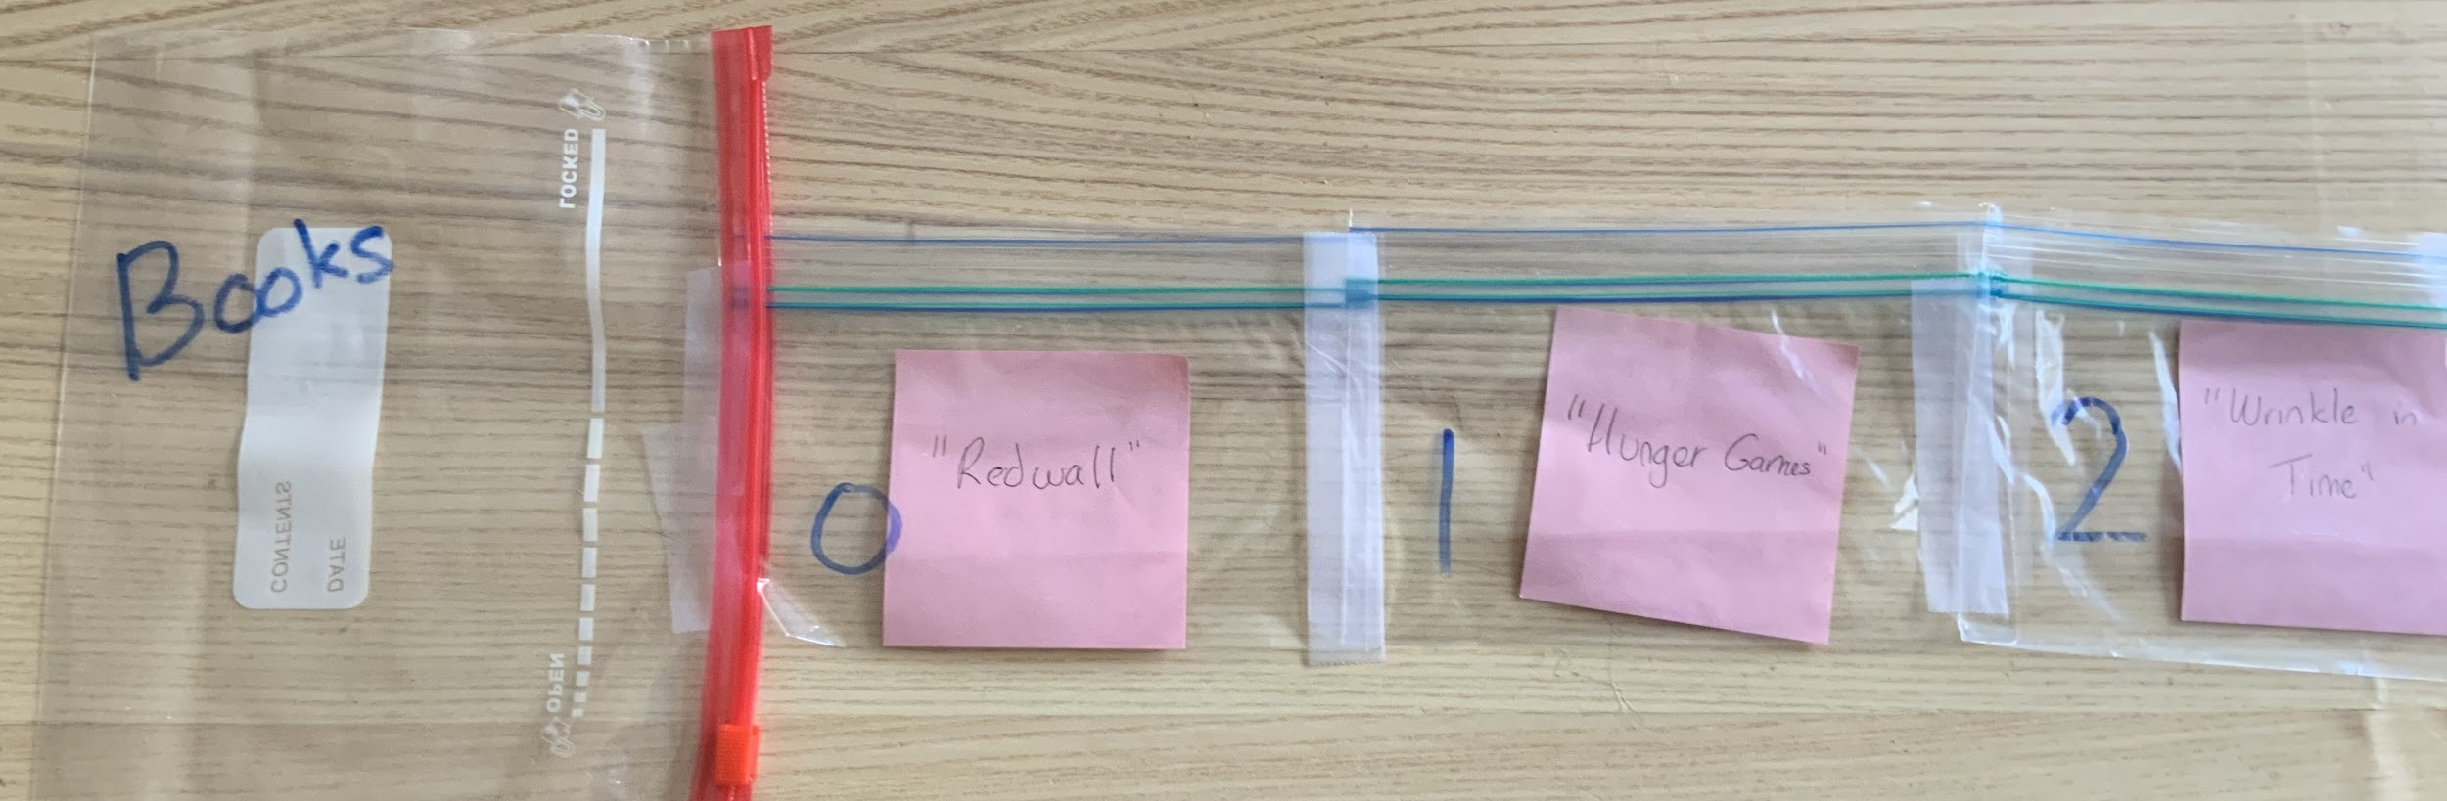
Unit 5 Lesson 1 - Activity
element
element
element
index
index
index
Your list is made up of elements. Each element has its own index. Indexes start at 0 and count up. The length of the list is how many elements it contains. This list has 3 elements and indexes from 0 to 2.

