Slide 1
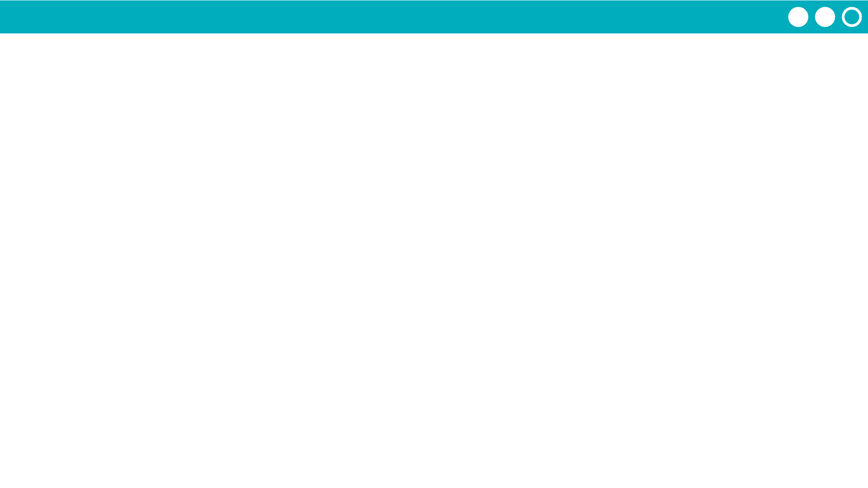
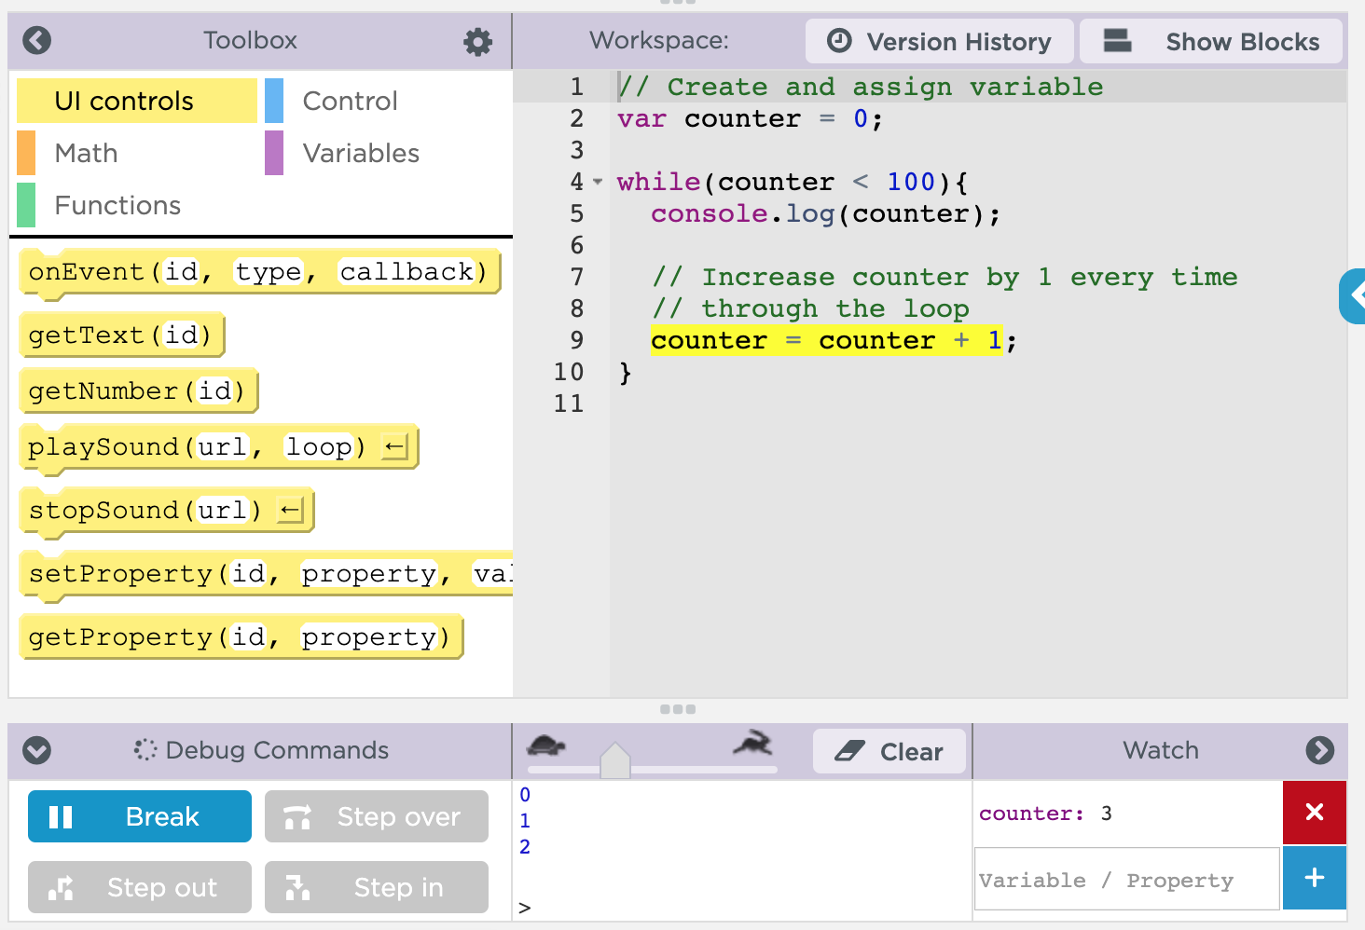
Unit 5 Lesson 7 - Activity
Debugging Loops
Use console.log to print out important information.
Run your code slowly so you can see how your loop is actually working.
Track your iterator variable in the Watch panel.

