Slide 1

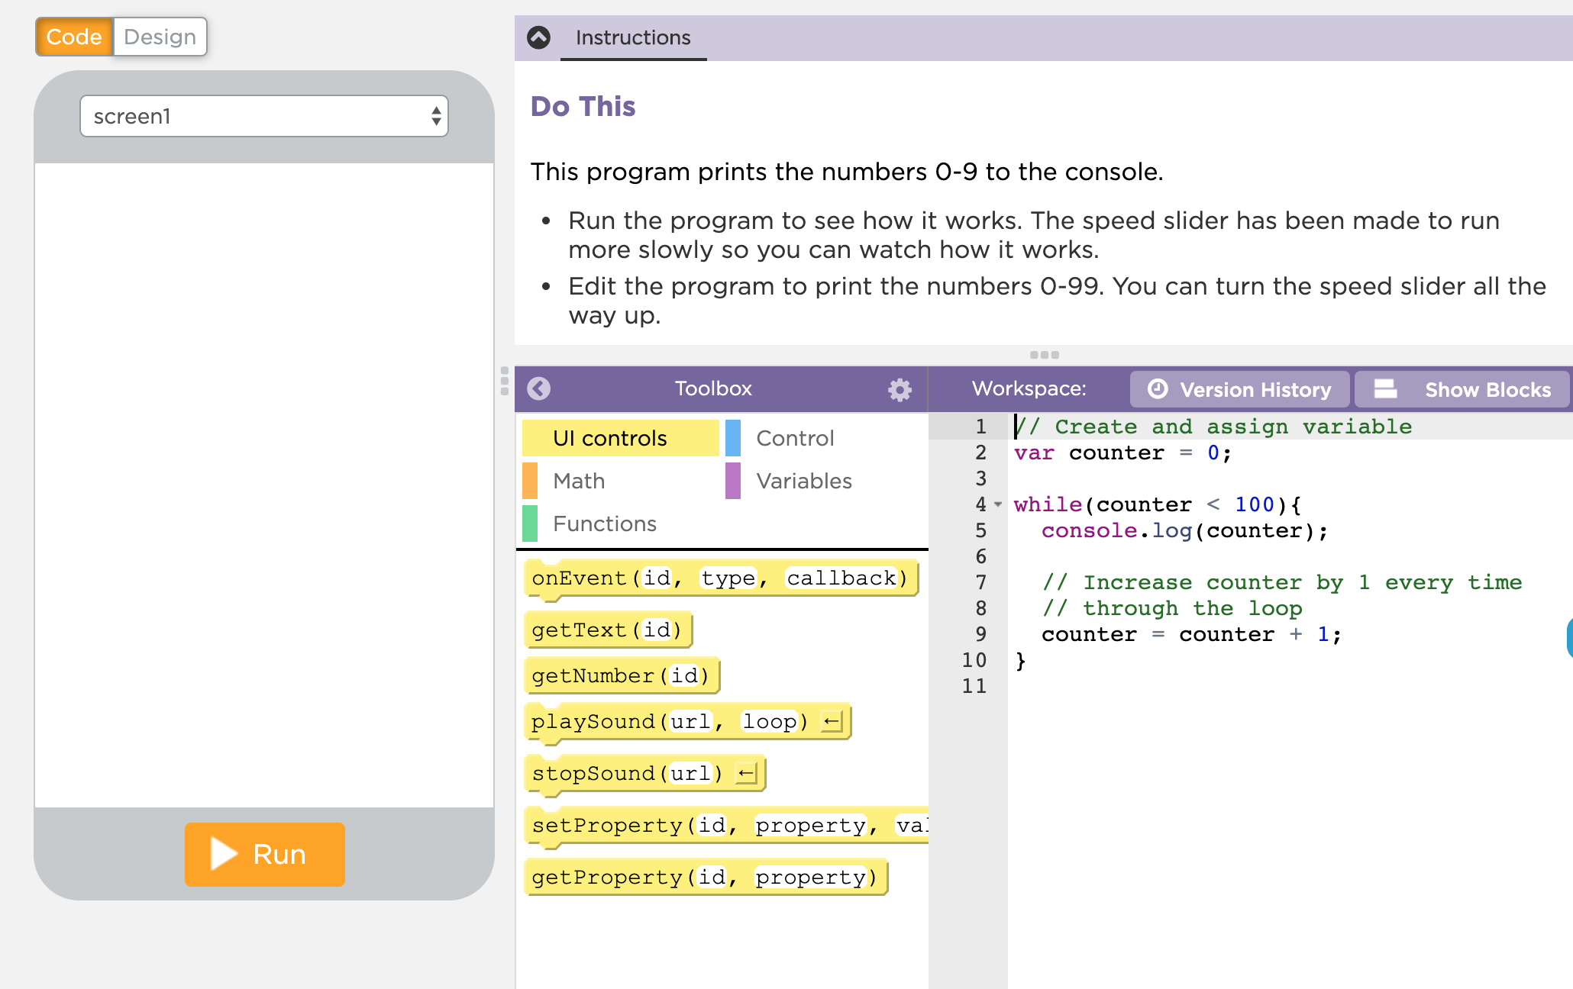

Unit 5 Lesson 7 - Activity
Loops Practice
Do This:
Navigate to Lesson 7, Level 1 on Code Studio

