Slide 1
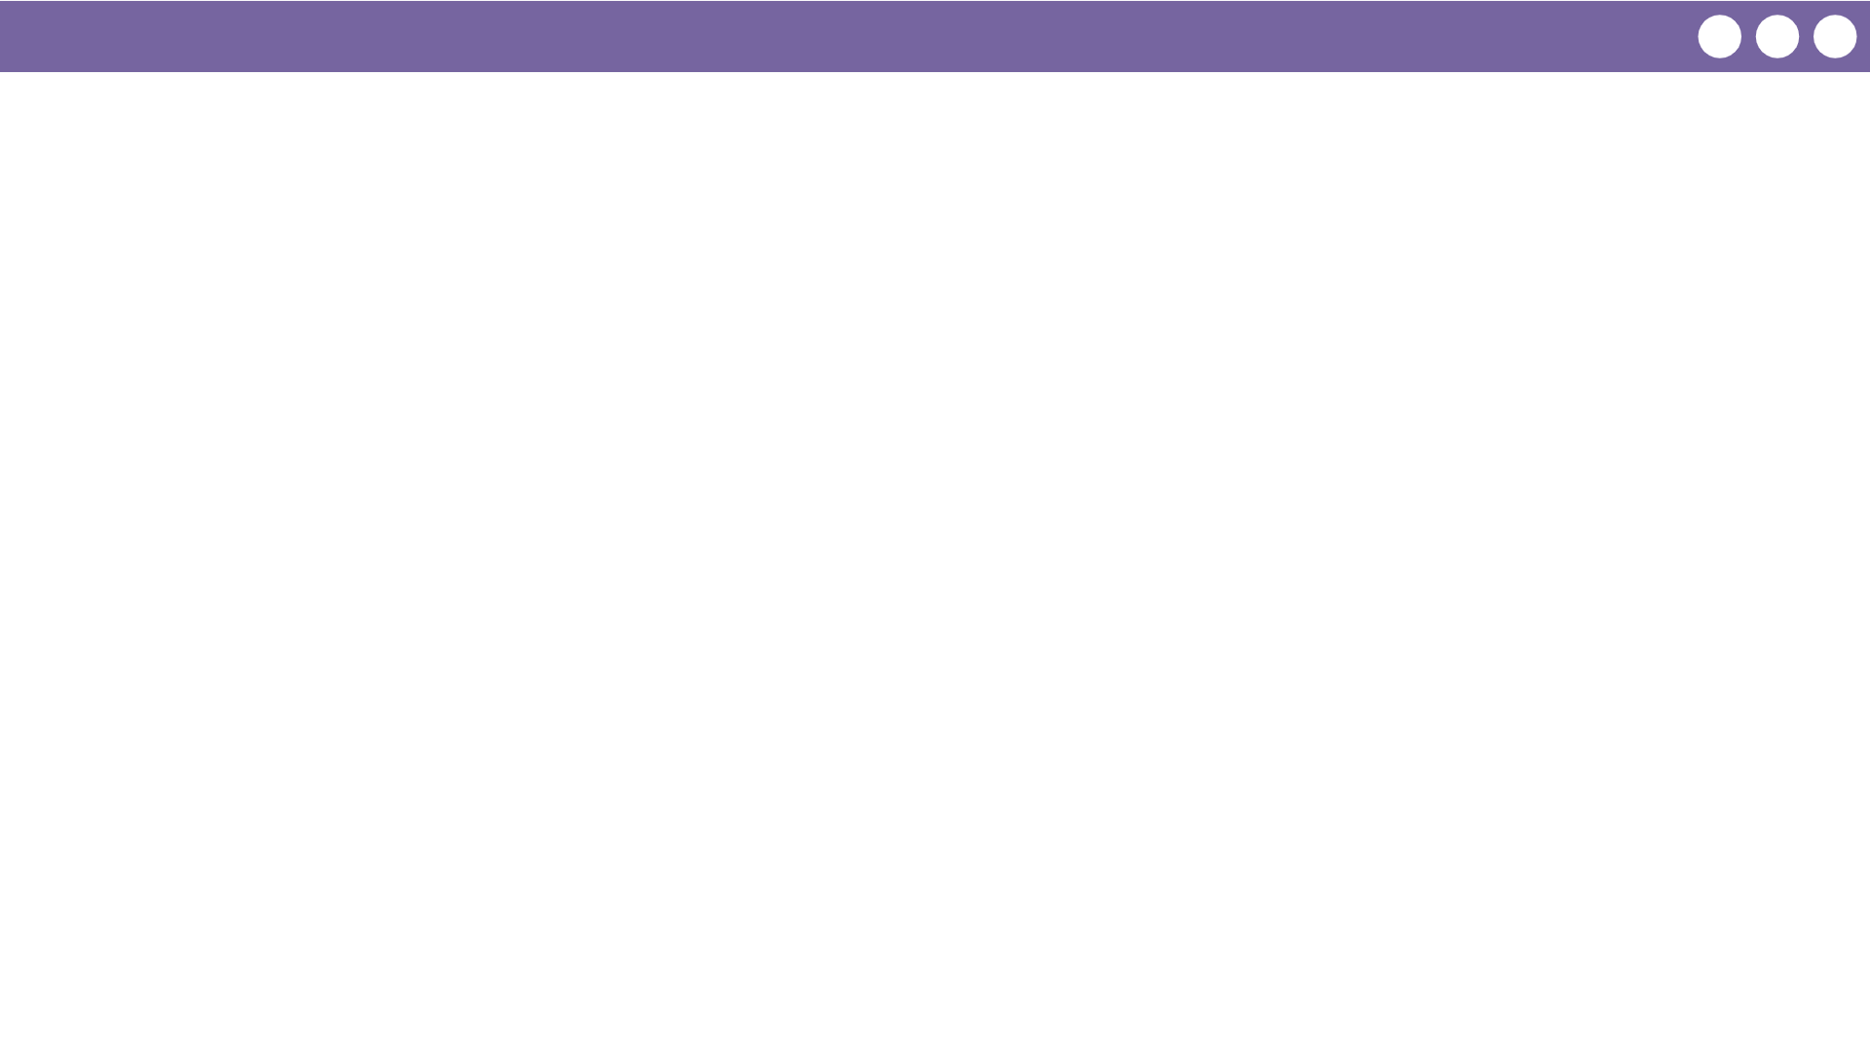
Unit 5 Lesson 7 - Wrap Up
Prompt:
What aspects of working with loops do you feel clicked today?
What do you still have trouble with?

