Slide 1
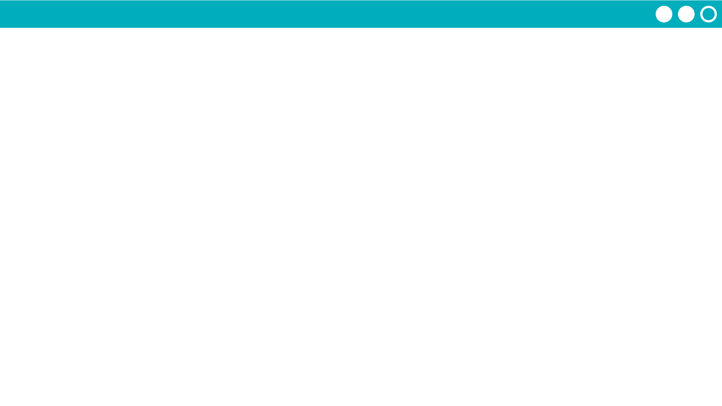
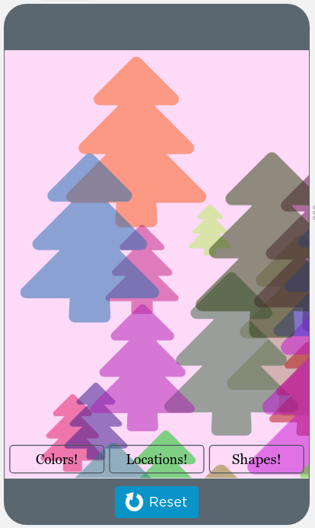

Unit 5 Lesson 8 - Activity
Loops Make:
Lock Screen Maker
Do This:
Navigate to Lesson 8, Level 1 on Code Studio

