Slide 1

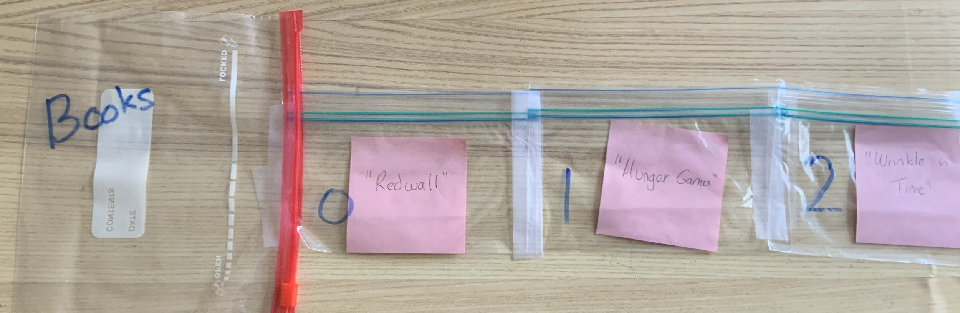
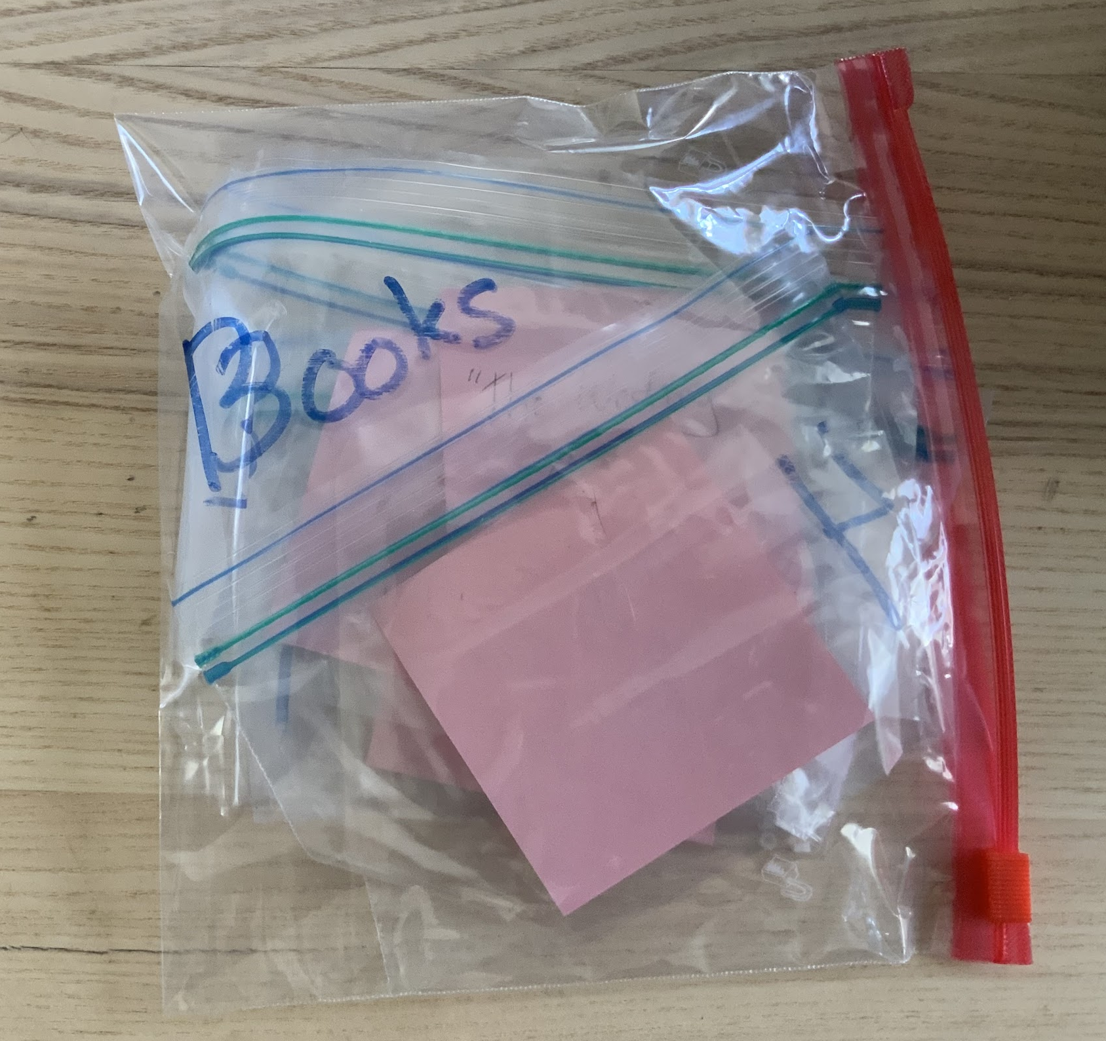
Unit 5 Lesson 1 - Activity
Notice that all the bags can be folded up and be placed inside the big variable baggie. Sometimes we want to think about the whole list, sometimes we want to think about individual elements

