Slide 1
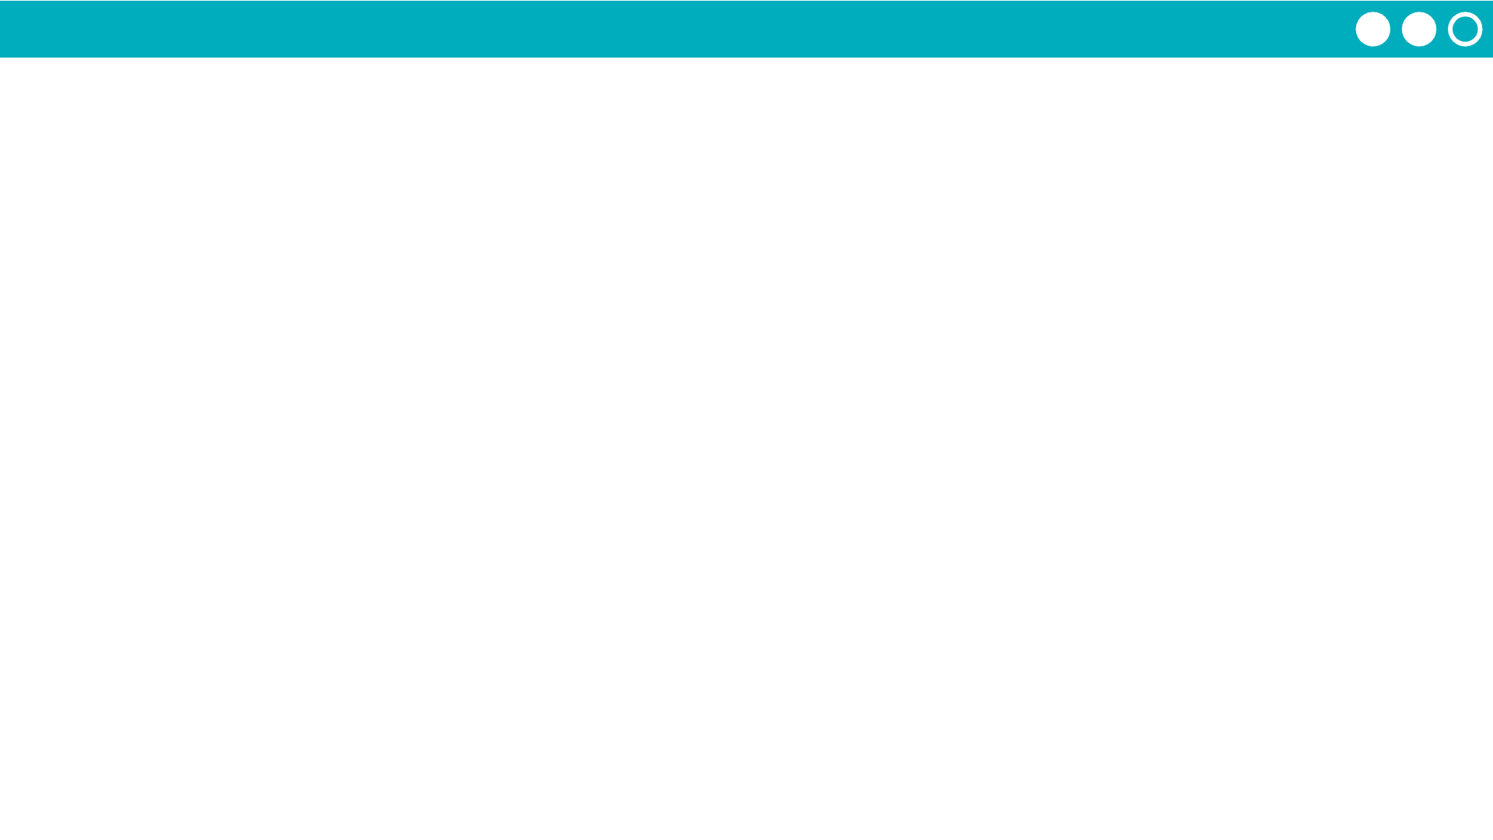
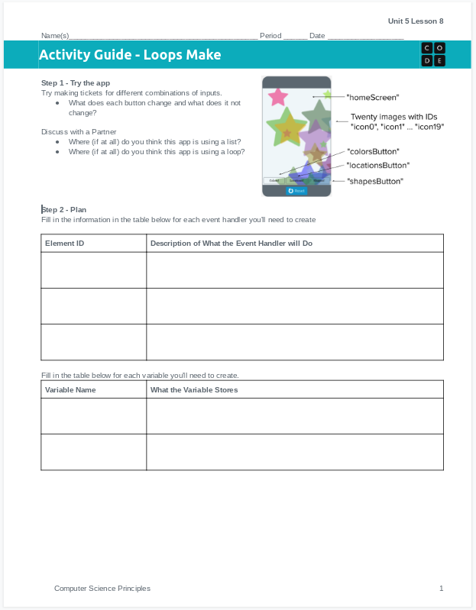
Unit 5 Lesson 8 - Activity
Do This: Make the Lock Screen Maker!
Use the activity guide to plan out your code, including the variables you'll create and the event handlers.
Step 3 includes steps you can follow to build the app, or you can use your own process.

