Slide 1

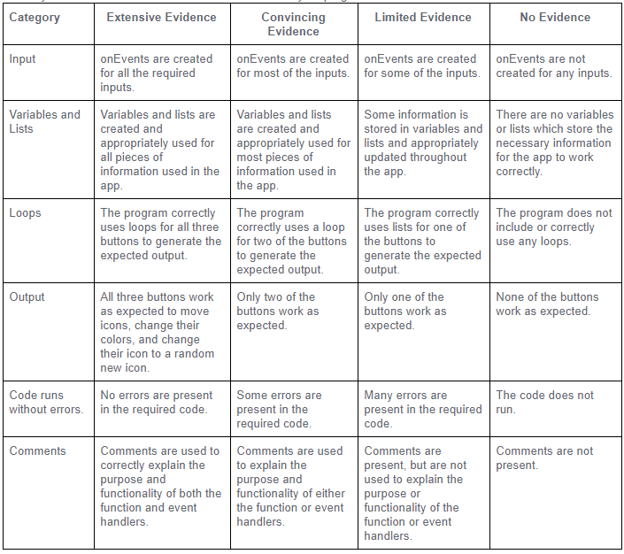
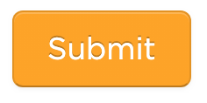
Unit 5 Lesson 8 - Activity
Don't forget: check the rubric before submitting

