Slide 1

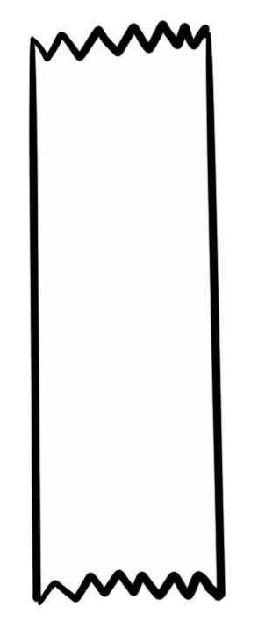
Unit 5 Lesson 1 - Activity
var myList = [“pizza”, 4]
This command creates a new list and assigns it to a variable
A list is indicated with square brackets
Each value in the list is separated by commas
Do This:
Write out the command that creates the list you just made.
Then write the command that makes another group’s list.
Share both answers with that group.
myList
“pizza”
4
0
1

