Slide 1


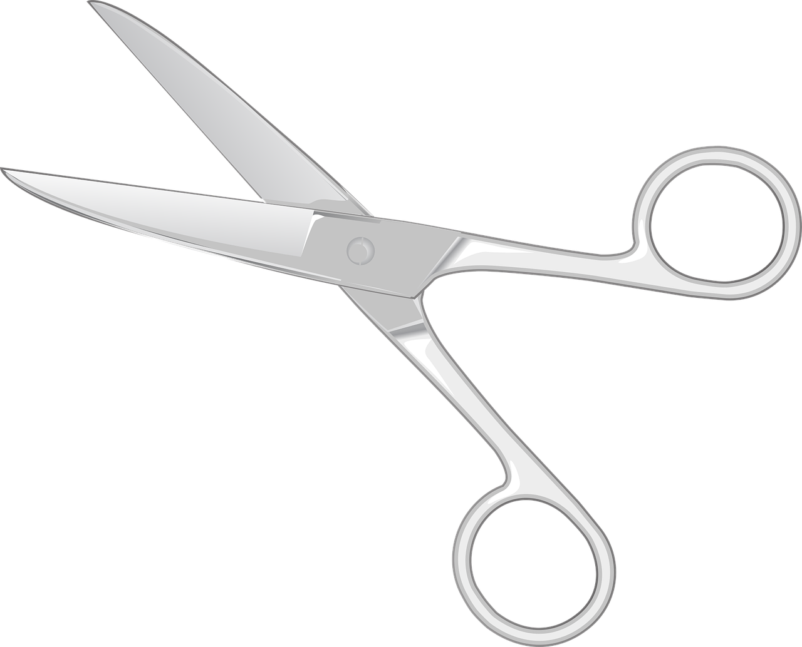
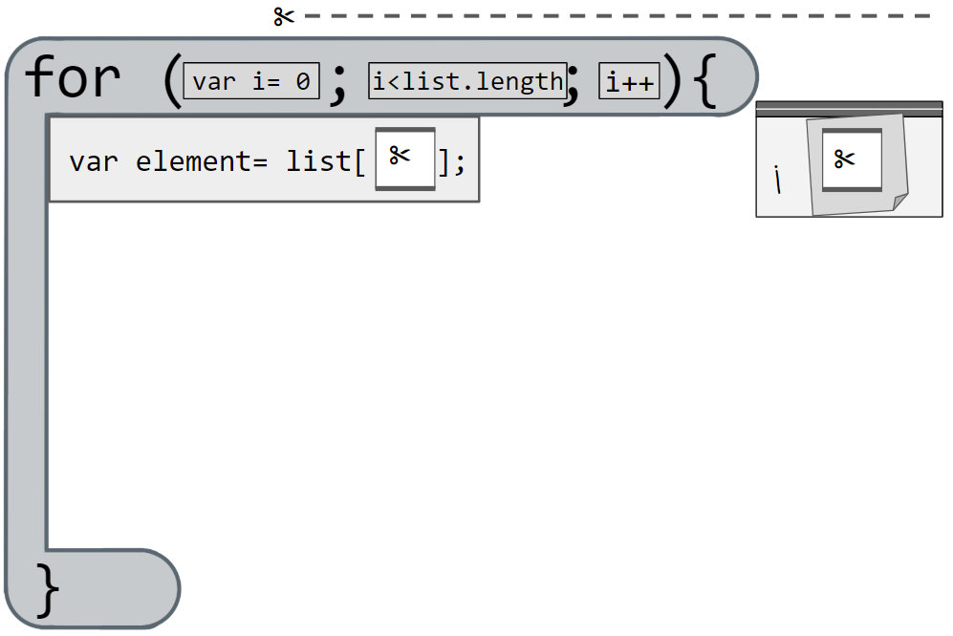
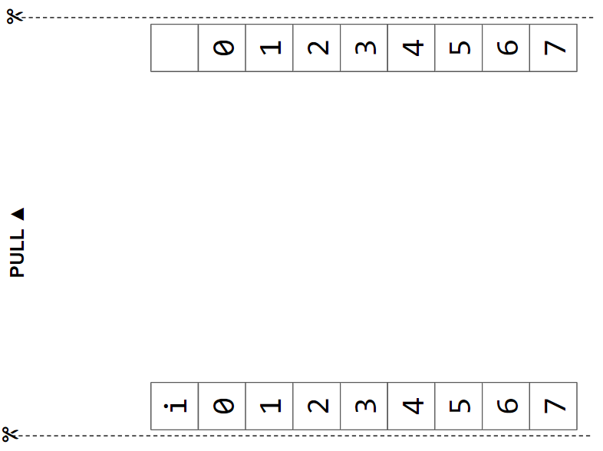
Unit 5 Lesson 9 - Activity
Traversals Explore
You and your partner should have:
A few baggies
Scissors
A few sticky notes
Pen/Pencil
Traversal Machine
MARKER

