Slide 1
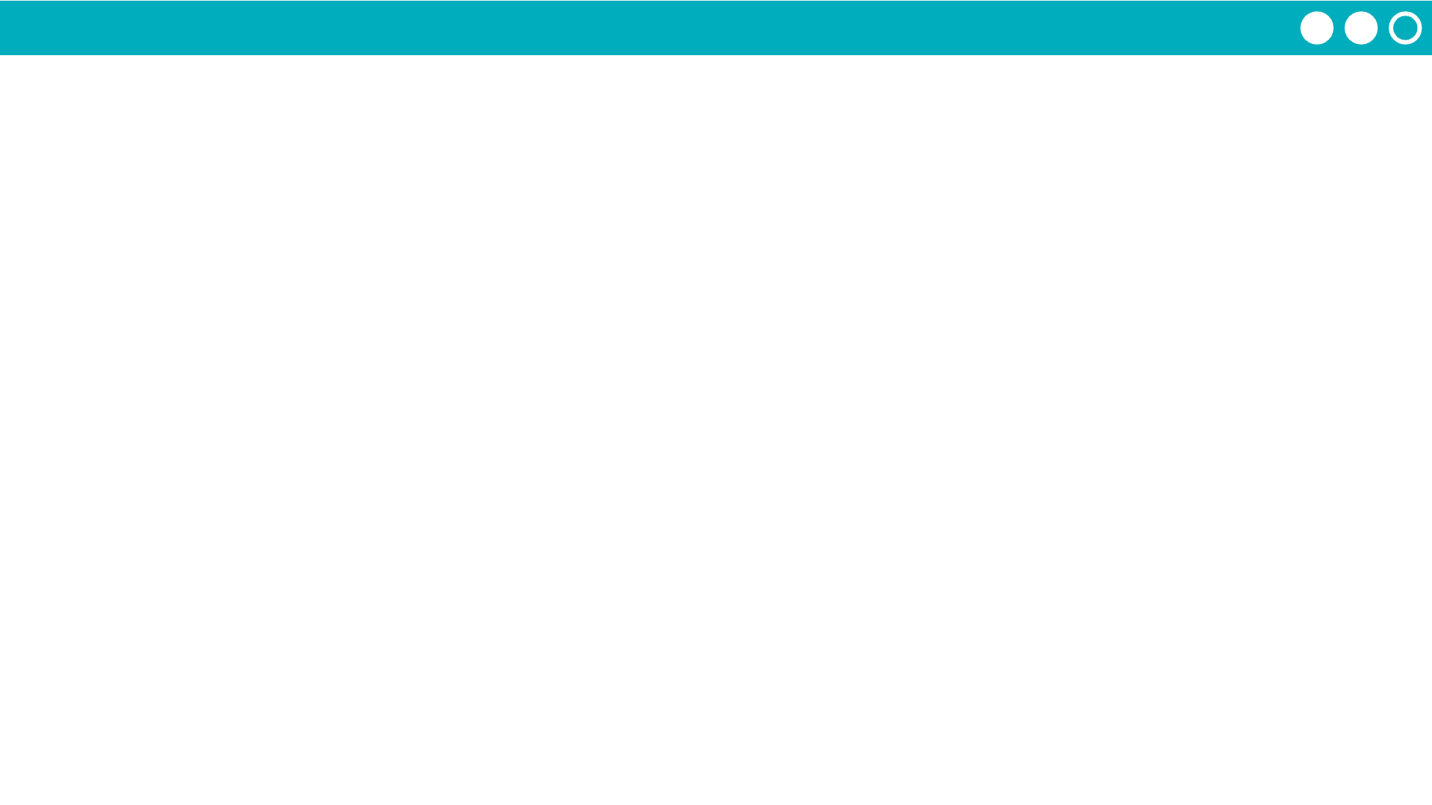
Unit 5 Lesson 9 - Activity
What if…
I want to know if a value is in a list.
With a partner, discuss the method you would use to look for an item in a list.
👀
Most likely, you would scan your list looking at each item until you found the correct one.

