Slide 1

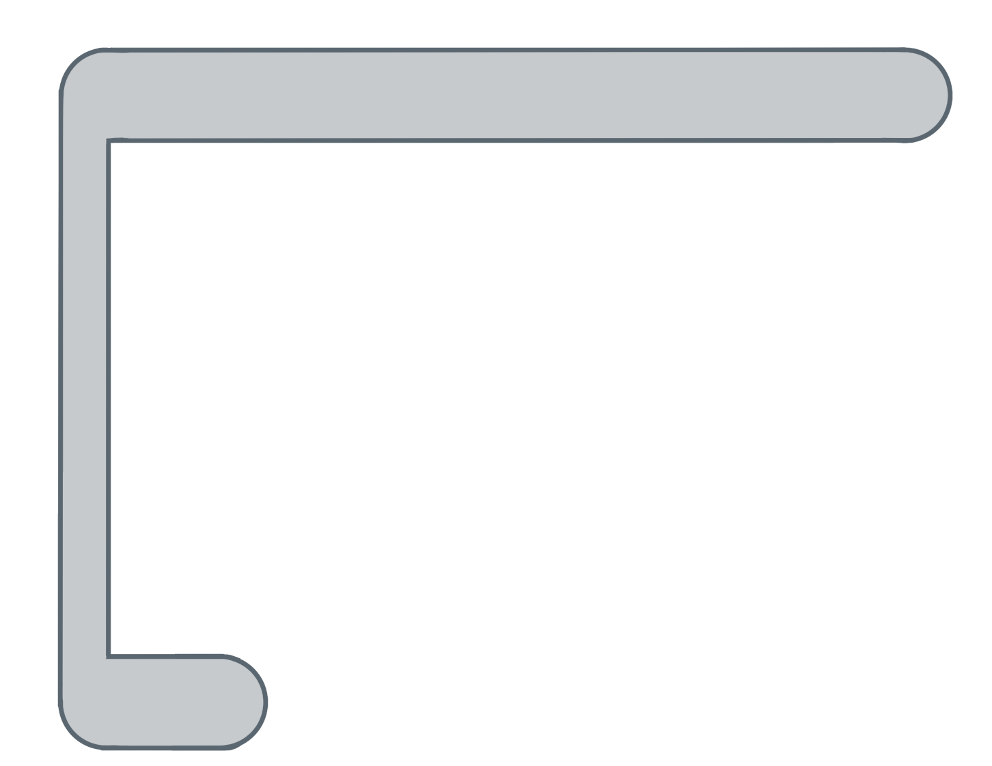
Unit 5 Lesson 9 - Activity
This is where we assign the starting value to the counter variable i. Usually we assign it to 0. What else starts with 0? The index of a list!
for ( ; ; ){
var i= 0
i<list.length
i++
var element= list[ ];
i
✂

