Slide 1

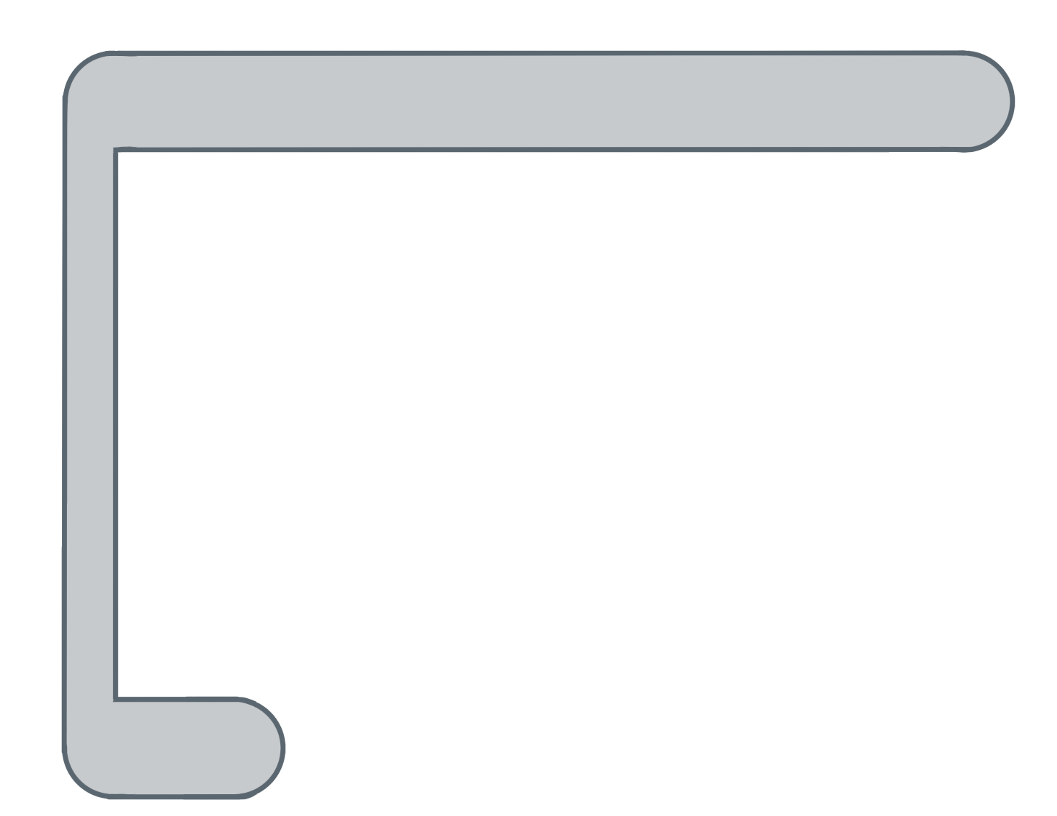
Unit 5 Lesson 9 - Activity
This is the Boolean expression that is checked to see if the loop should continue to run. When working with a list, we want to access every element in the list, so we are going to keep the loop going until we have hit list.length.
for ( ; ; ){
var i= 0
i<list.length
i++
var element= list[ ];
i
✂

