Slide 1

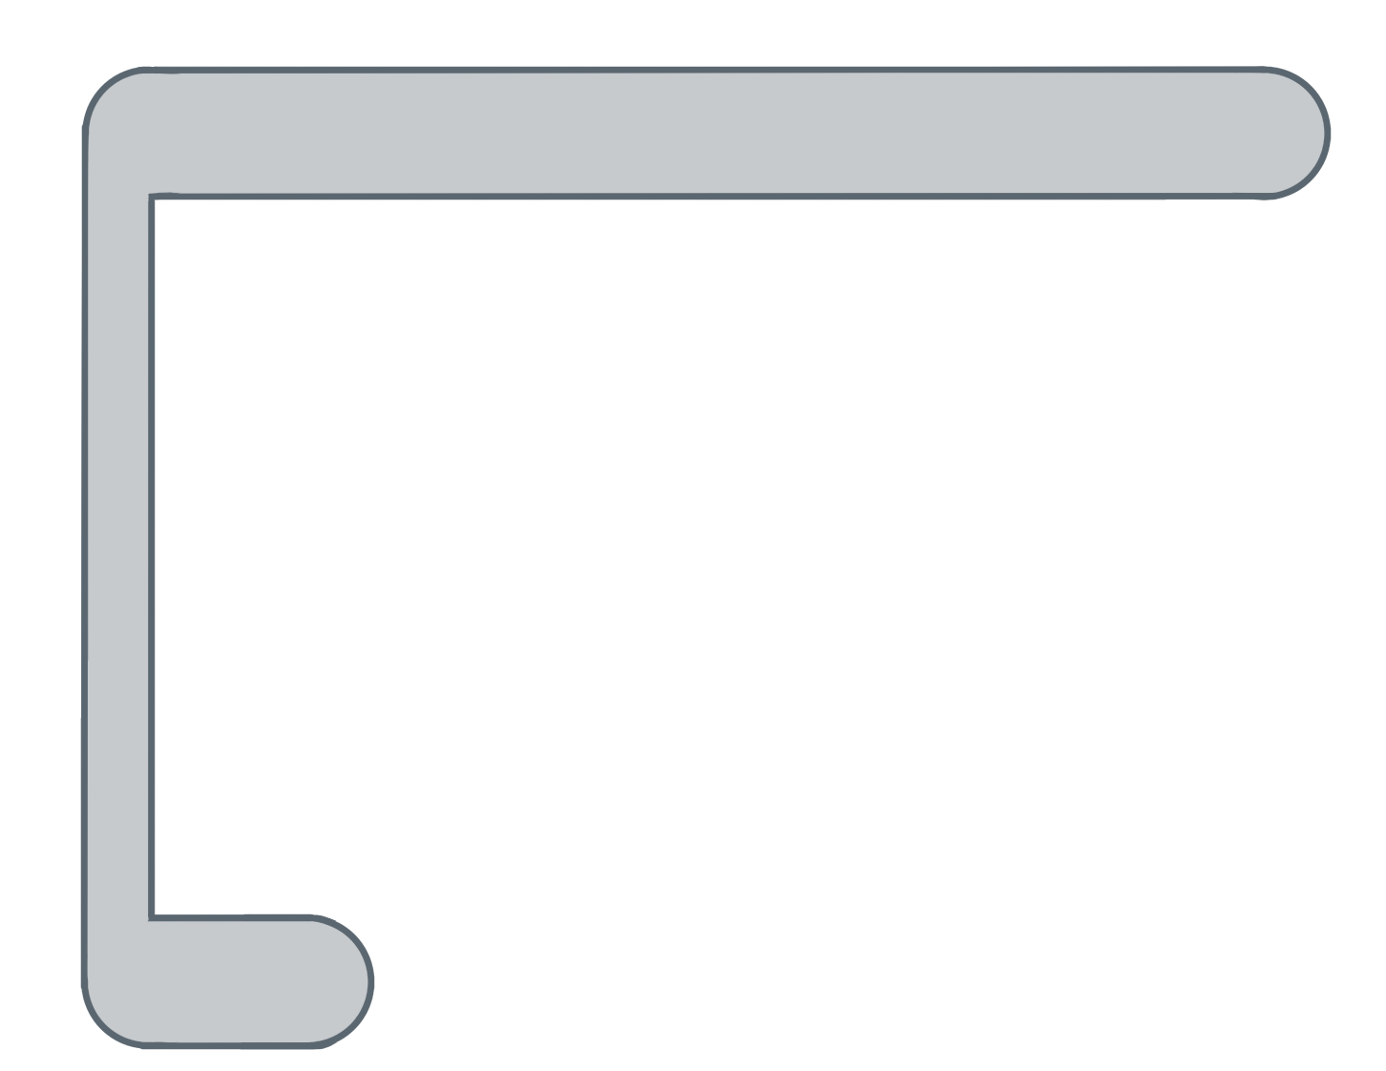
Unit 5 Lesson 9 - Activity
The counter variable i increases after each loop runs.
for ( ; ; ){
var i= 0
i<list.length
i++
temps
var element= list[ ];
i
temps
✂

