Slide 1

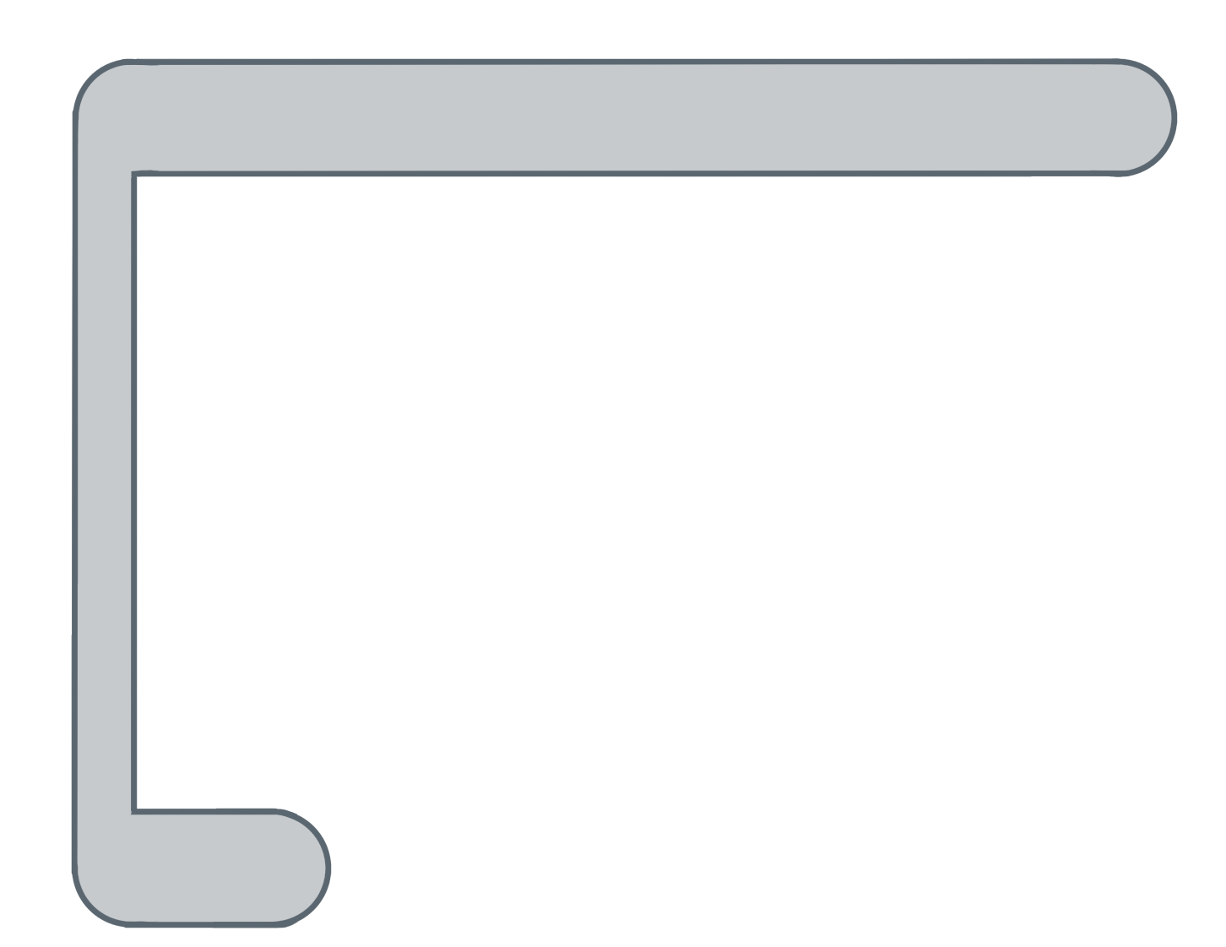
Unit 5 Lesson 9 - Activity
for ( ; ; ){
var i= 0
i<list.length
i++
temps
var element= list[ ];
i
temps
0
i
0
✂
Do this:
Look at the list below
Right now i = 0.
Evaluate the statement in the for loop to see what value is stored by the variable element.
77
element
}
var temps = [ 77, 85, 89, 65 ];
0 1 2 3

