Slide 1

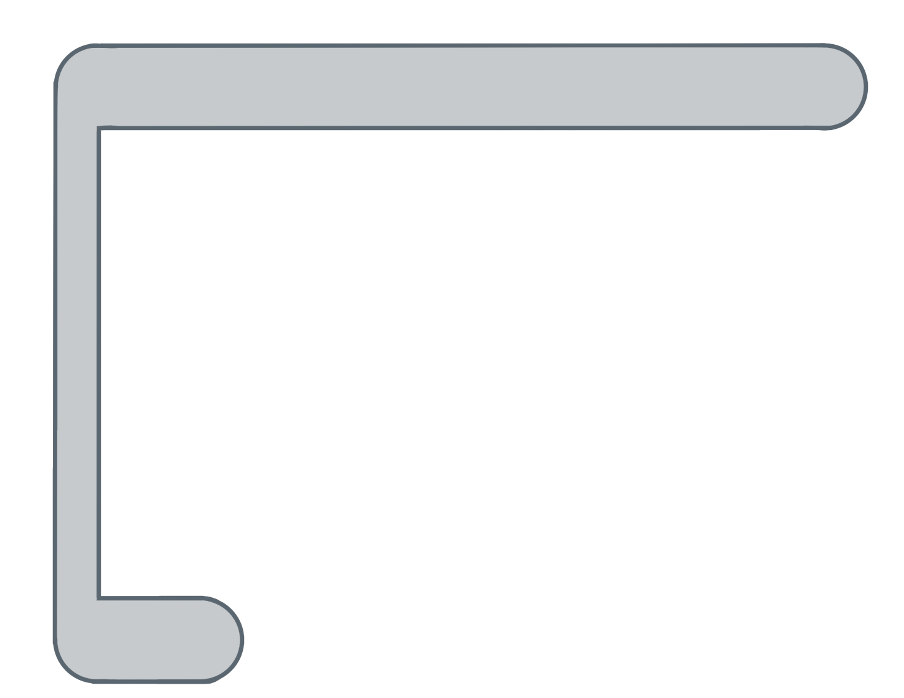
Unit 5 Lesson 9 - Activity
for ( ; ; ){
var i= 0
i<list.length
i++
temps
var element= list[ ];
i
temps
i
i
0
✂
if (element < min) {
min = element;
}
Do this:
Now I want to find the smallest number in my list. I am going to reduce the list to the smallest number.
We are going to leave the baggies behind now. You can use a scrap piece of paper to store the global variable:
var min = temps[0];
Evaluate that statement to find the value stored in min.
Run the program.
Update the variable min as needed.
}

