Slide 1
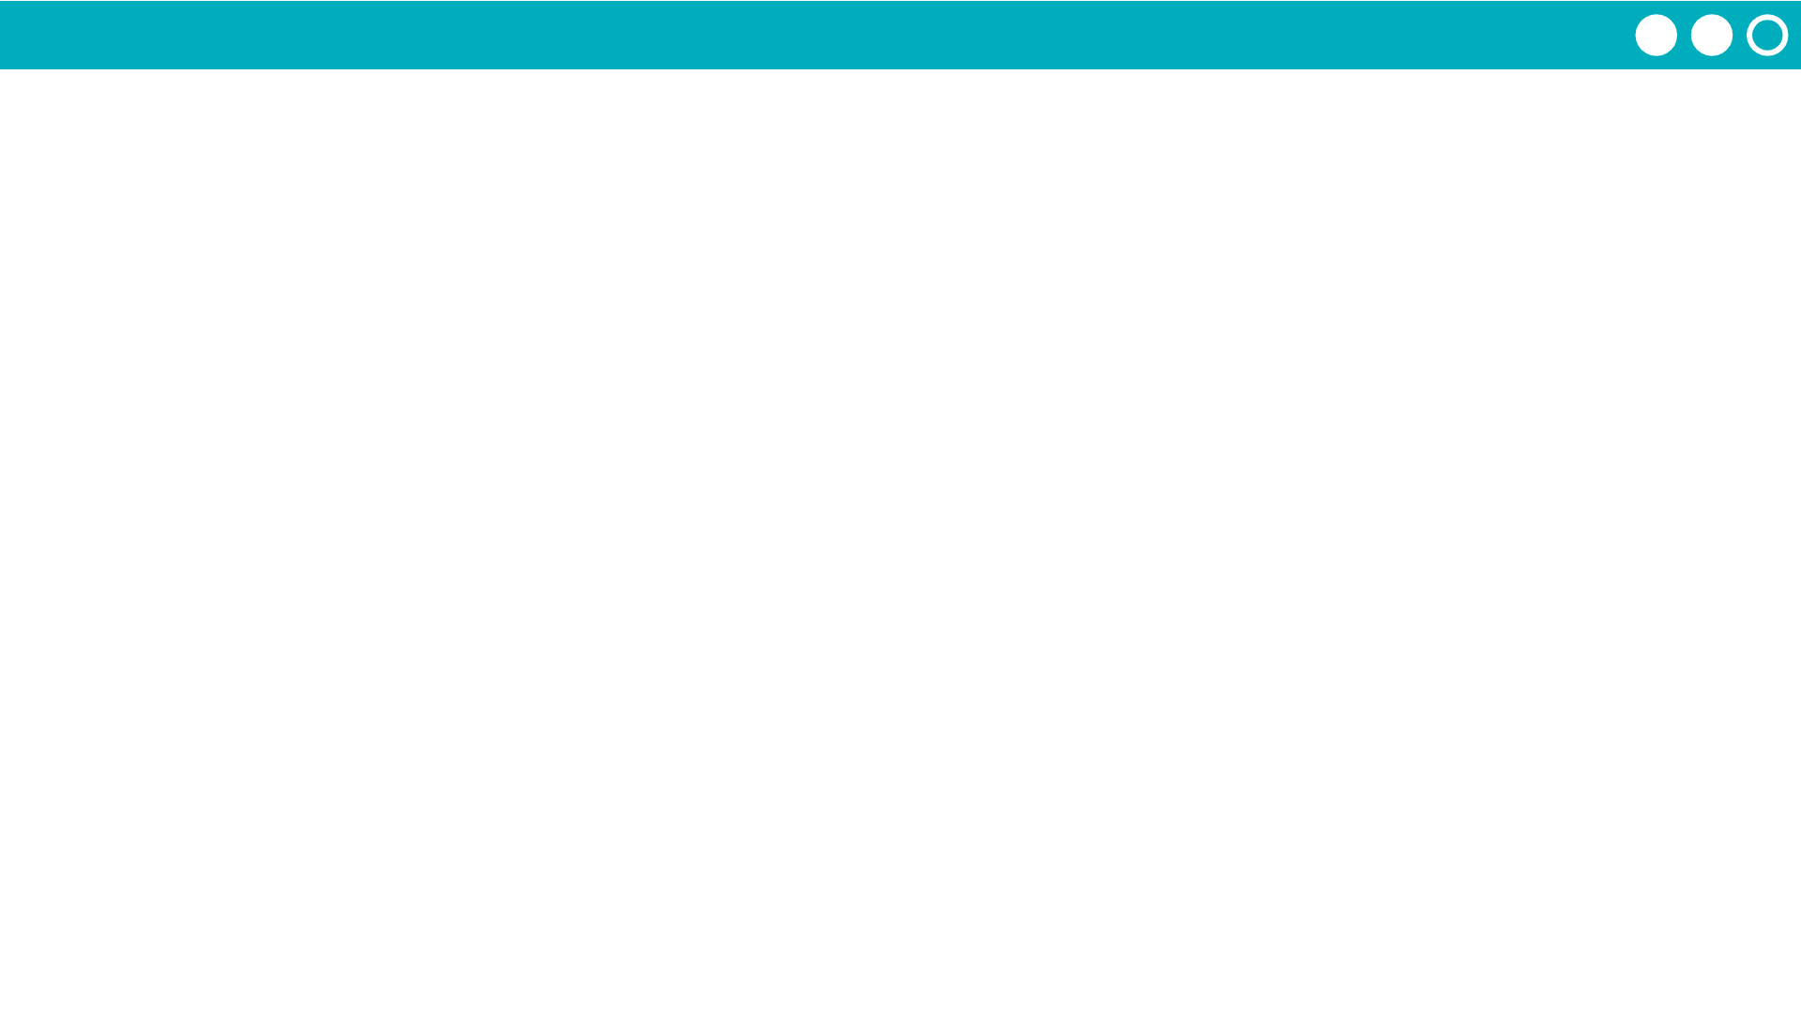

Unit 5 Lesson 1 - Activity
Lists and Expressions
Replace the list access with a copy of the value it holds
Evaluate the expression as normal
3
myNumbers[1]
3
20
evaluates to
23
myNumbers
myNumbers[0] + myNumbers[2]
10
20
25
0
1
2
10
25
evaluates to
35
Do This: Write three expression that include accesses to the list you created. Use the examples above for inspiration
Trade with another group and have them evaluate your expressions

