Slide 1

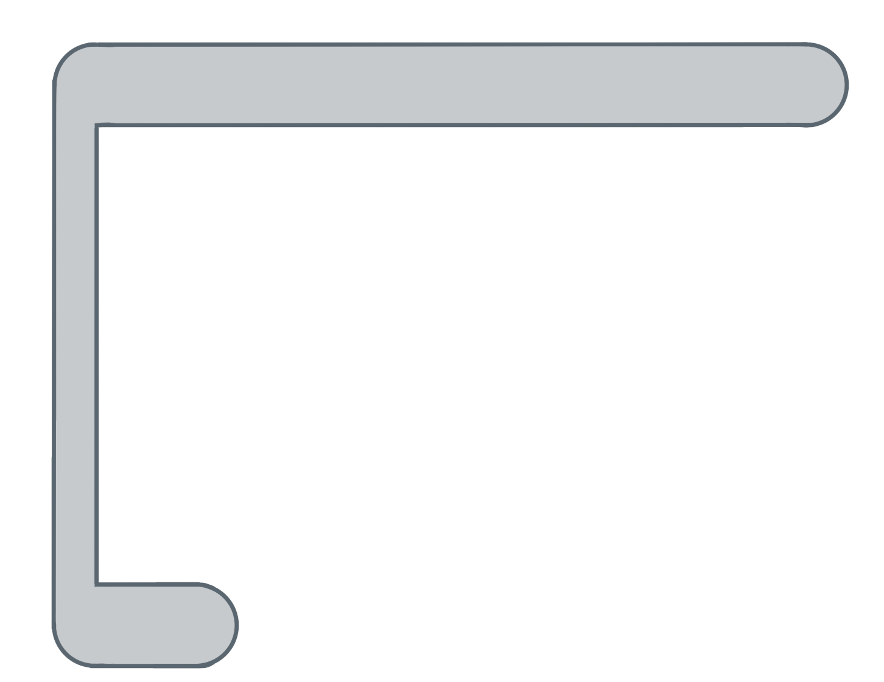
Unit 5 Lesson 9 - Activity
for ( ; ; ){
var i= 0
i<list.length
i++
temps
var element= list[ ];
i
4
temps
4
i
0
✂
if (element < min) {
min = element;
}
The smallest number in the list is 65.
}

