Slide 1
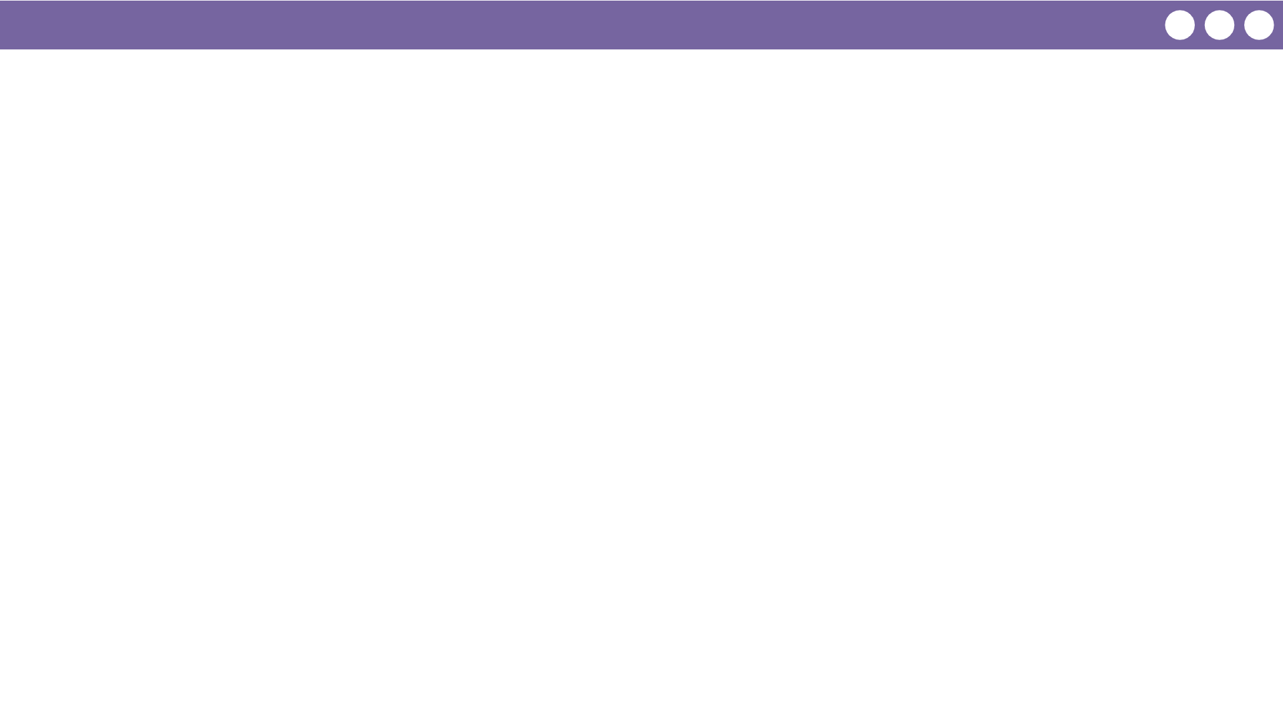
Unit 5 Lesson 9 - Wrap Up
Key Takeaways
We use a for loop to traverse a list, visiting each element one at a time.
Each pass through the loop, the counting variable changes - usually by one. We can access each element by evaluating list[i] in the for loop.
Once we know the element at each spot in a list, we can do different things with it:
Filter (create a subset of elements from the original list)
Reduce (reduce the list down to a single element, for example: the smallest number in the list)

