Slide 1

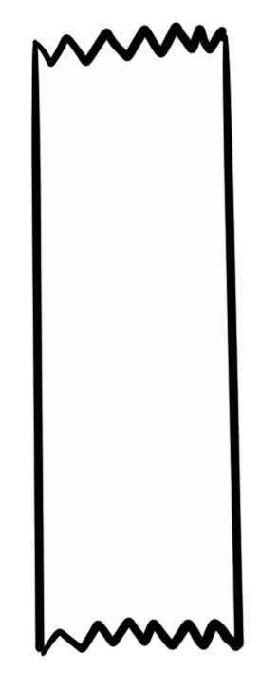
Unit 5 Lesson 1 - Activity
myList[1] = “hello”
Assigns the value on the right to the index
Just like variable assignment, the old value is thrown away and replaced.
myNumbers
00 var myNumbers = [10,20,25];
01 myNumbers[0] = 5;
02 myNumbers[2] = 30;
10
20
25
0
1
2
myNumbers
5
20
25
0
1
2
myNumbers
Do This: Discuss what the list will contain after line 02 runs.
5
20
30
0
1
2

