Slide 1

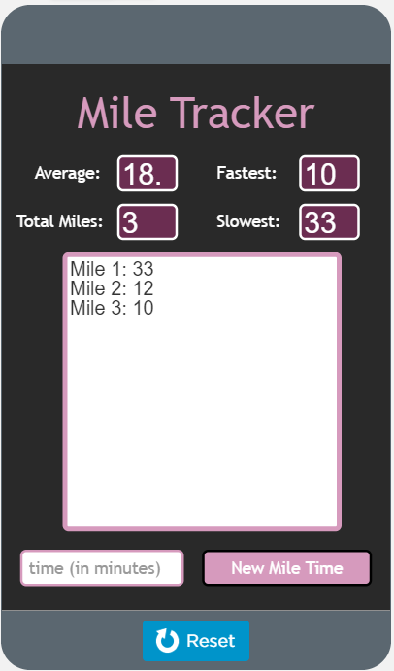
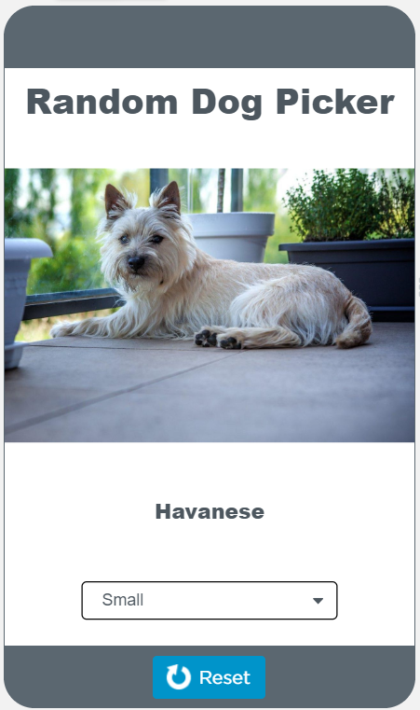
Unit 5 Lesson 10 - Activity
Traversals Investigate
Do This:
Get into groups of four. Assign each student in a group a different letter (A, B, C, D)
Navigate to Level 1

