Slide 1

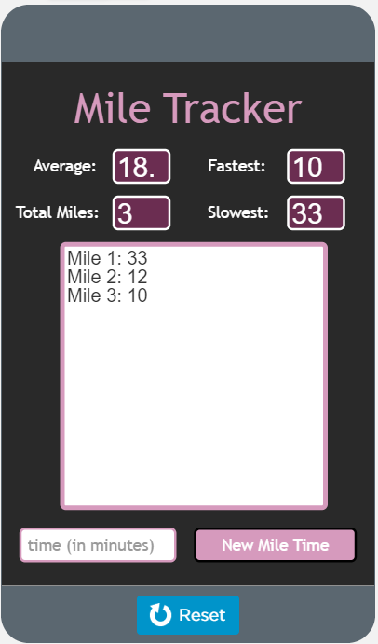
Unit 5 Lesson 10 - Activity
Level 1:
Read through the entire code
Each student focuses their attention on a single function. Re-read the code for that function.
Student A: average() (lines 32-38)
Student B: slow() (lines 40-48)
Student C: fast() (lines 50-58)
Student D: numberedListDisplay() (lines 60-66)

