Slide 1
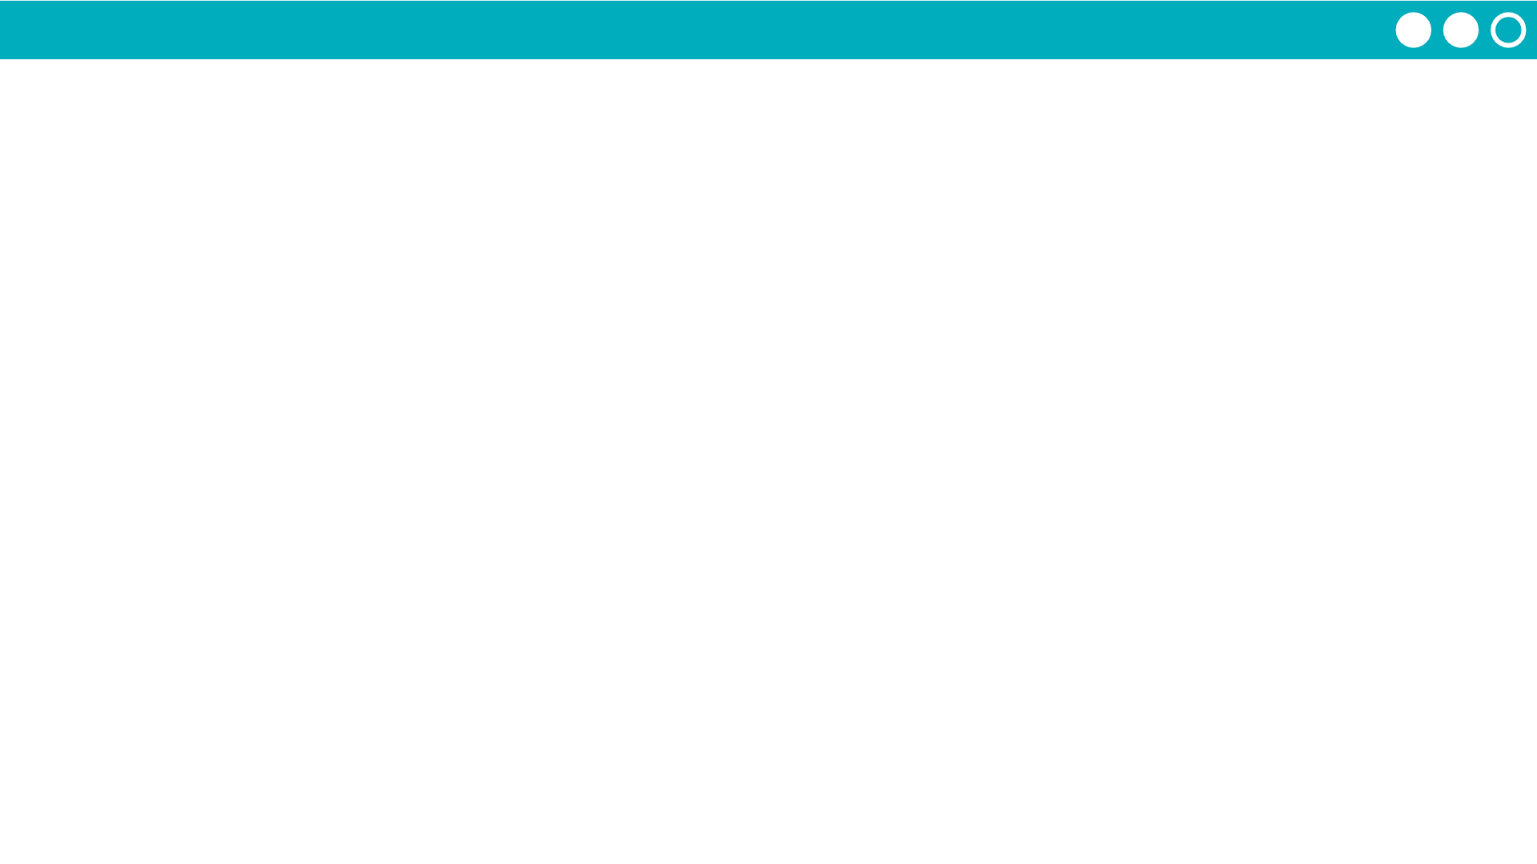
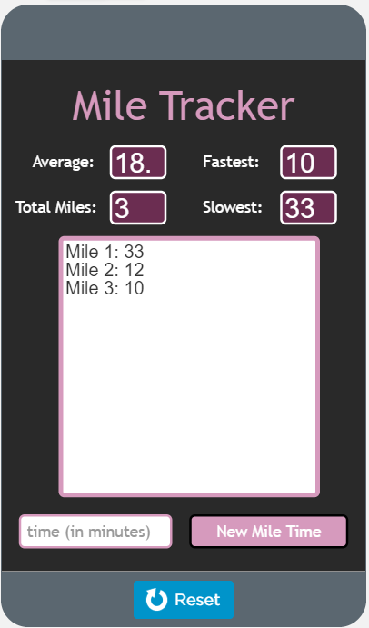
Unit 5 Lesson 10 - Activity
Discuss in your group:
How does your function work?
What list does it use?
How is it traversed using a for loop?
Discuss as a class:
How does the app work?

