Slide 1
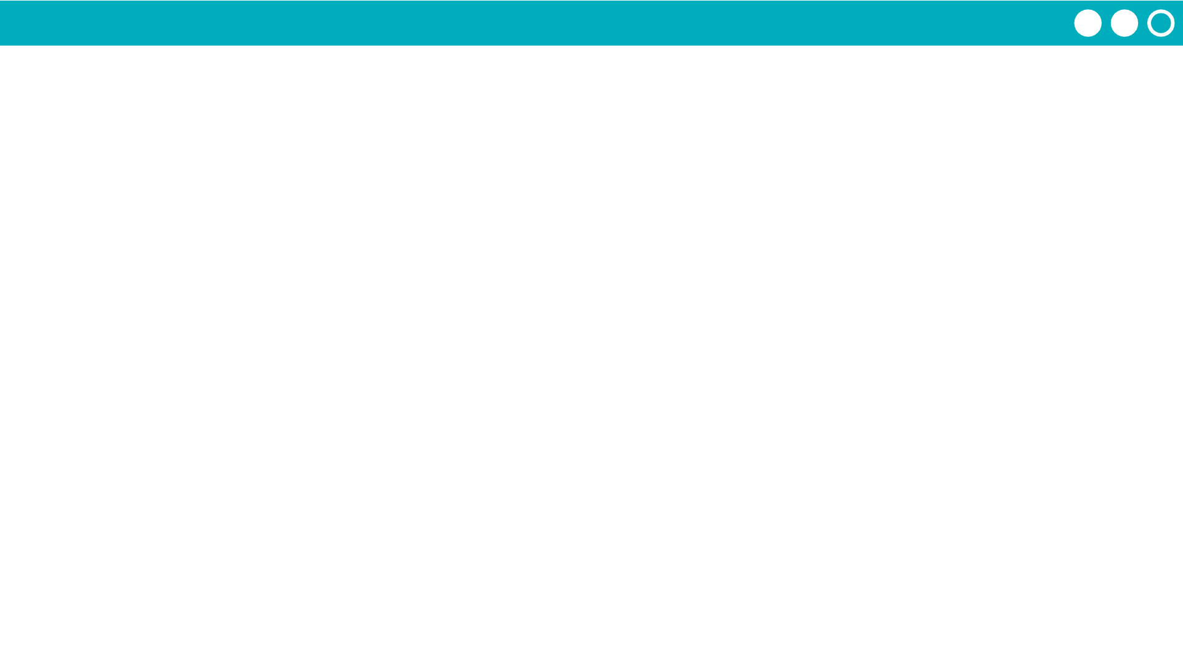
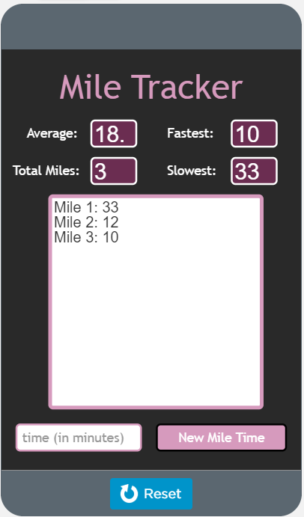
Unit 5 Lesson 10 - Activity
Modify with a partner:
Create a function that adds together the total time of every element in the list.
console.log the result.
Call this function in the updateScreen() function.

