Slide 1
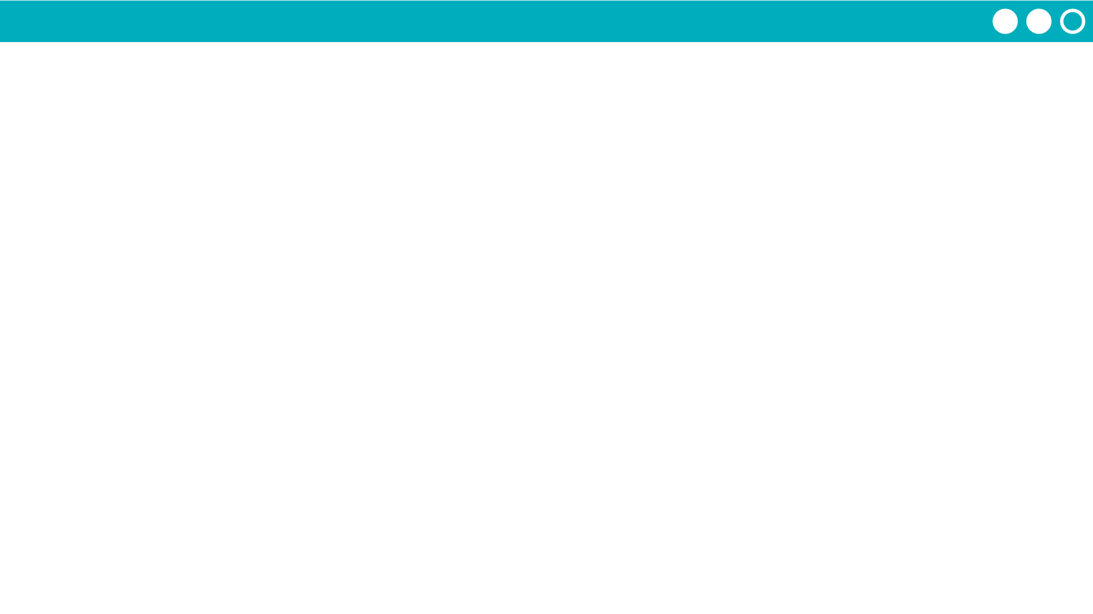

Unit 5 Lesson 10 - Activity
Do This:
Navigate to Level 2 with a partner
Read through the code and run the app. What looks new?
Open the data tab. Investigate!
How does it work?
What information is available?
What can you change? What can't you change?
Investigate a few different datasets.

