Slide 1
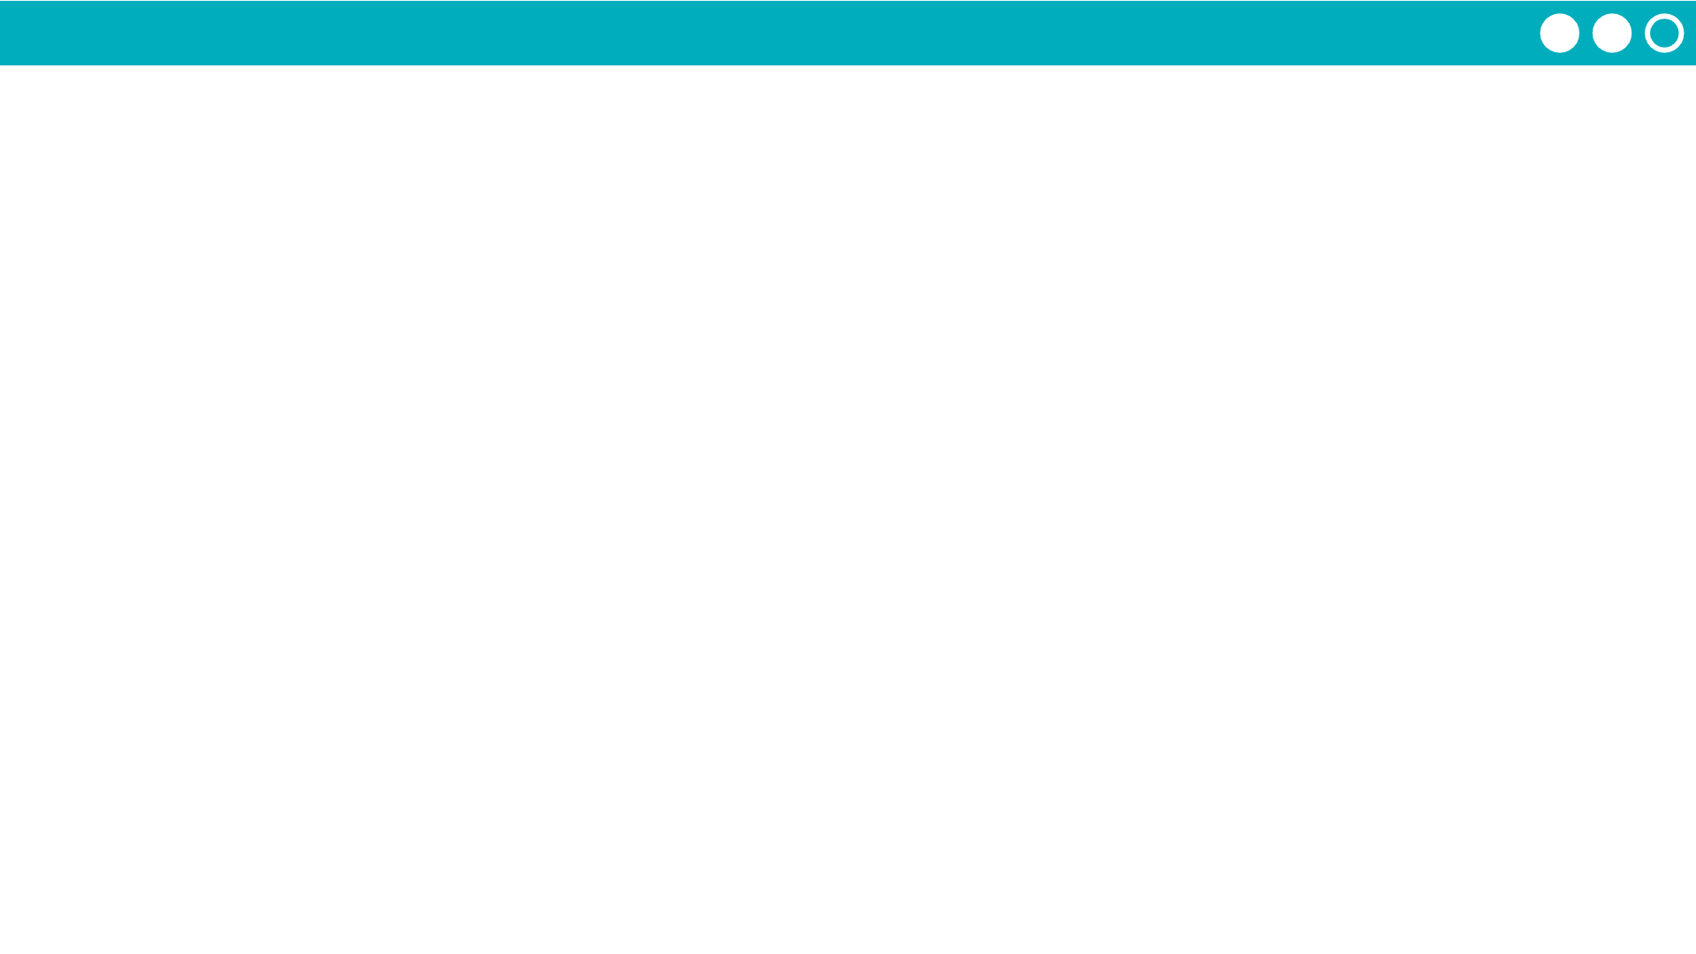
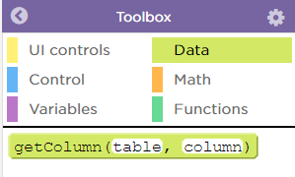
Unit 5 Lesson 10 - Activity
Do This:
Modify the code!
Choose a dataset and import it to your project.
Look at the code. Check out the "data" drawer in the toolbox.
Modify to print out a column of data from your chosen dataset.

