Slide 1
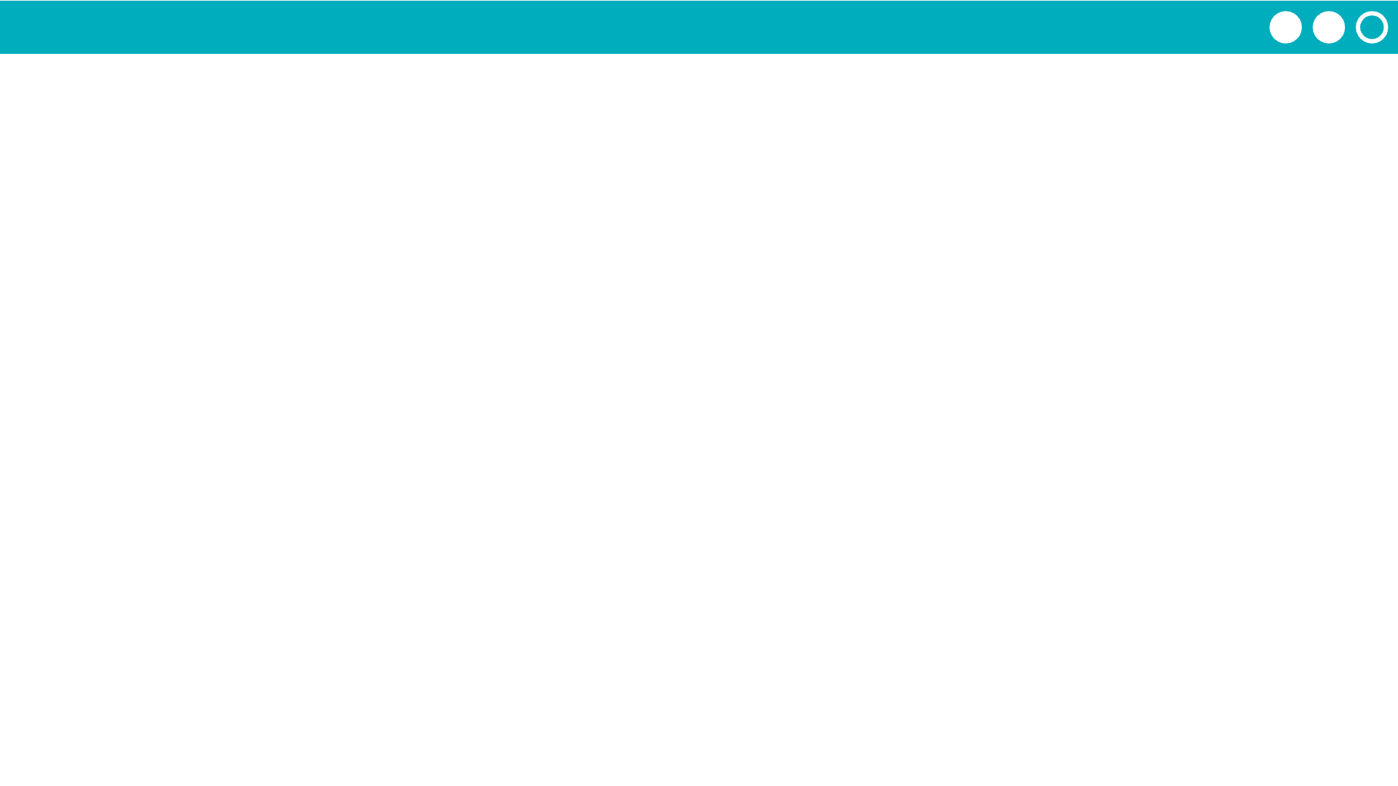
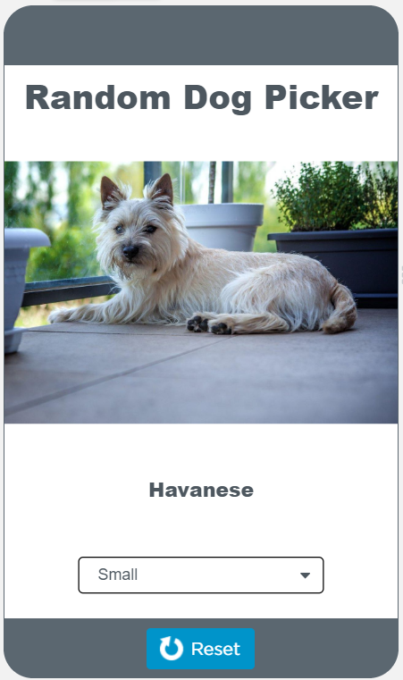
Unit 5 Lesson 10 - Activity
Do This:
Navigate to Level 3 with a partner
Follow the directions on the screen
Note: Read the code very carefully!

