Slide 1

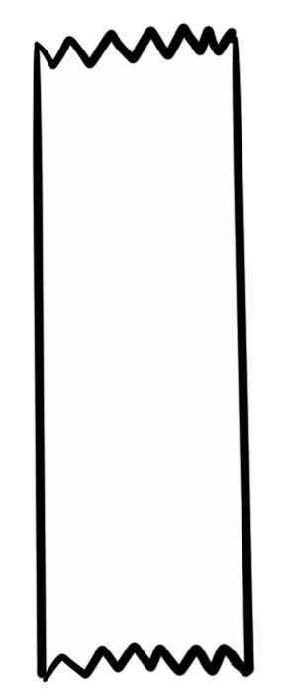
Unit 5 Lesson 1 - Activity
Do This:
Run this program. Compare your result with another group.
00 var myStuff = [20, “hat”, “pow”, 5];
01 myStuff[1] = “cat”;
02 myStuff[2] = myStuff[1];
03 myStuff[0] = myStuff[3] + 10;
04 myStuff[3] = myStuff[0] + myStuff[0];
myStuff
15
“cat”
“cat
30
0
1
2
3

