Slide 1

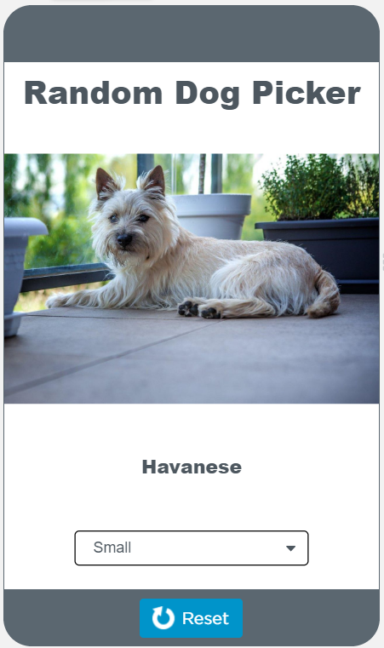
Unit 5 Lesson 10 - Activity
Discuss as a Class:
What are the names of the five lists in this program?
On what lines of code are the lists created?
On what lines of code are the lists filled?
How are these lists filled?
Open up the data tab and click to view the dogs table. What columns does this app use?
Look at the filter function. On what lines are the filtered lists reset to blank lists?
What condition is being checked to determine if an element belongs in a filtered list?

