Slide 1
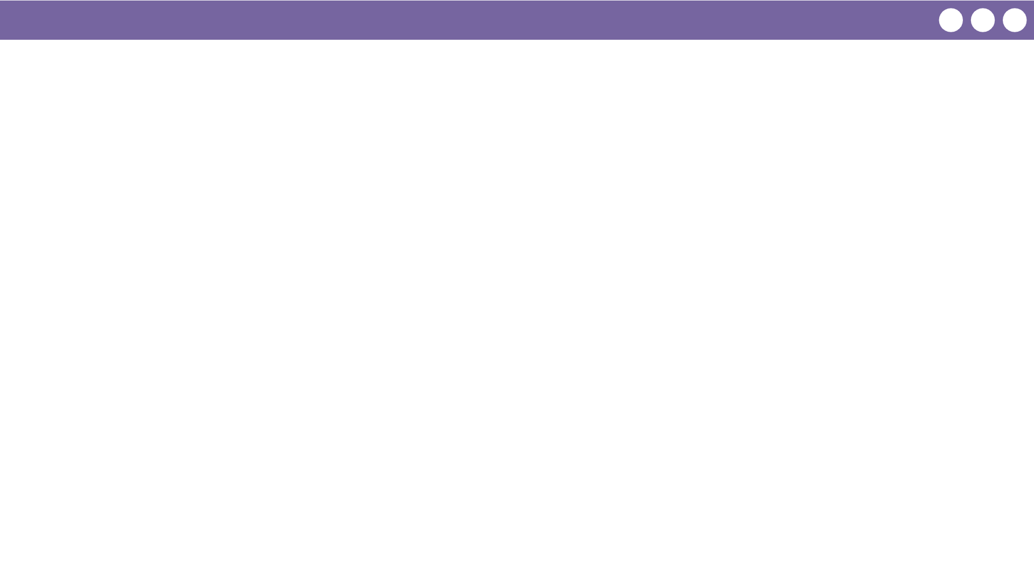
Unit 5 Lesson 10 - Wrap Up
Prompt:
What aspects of using traversals to process a list do you already understand? What questions do you want to dig into more tomorrow during the practice lesson?

