Slide 1
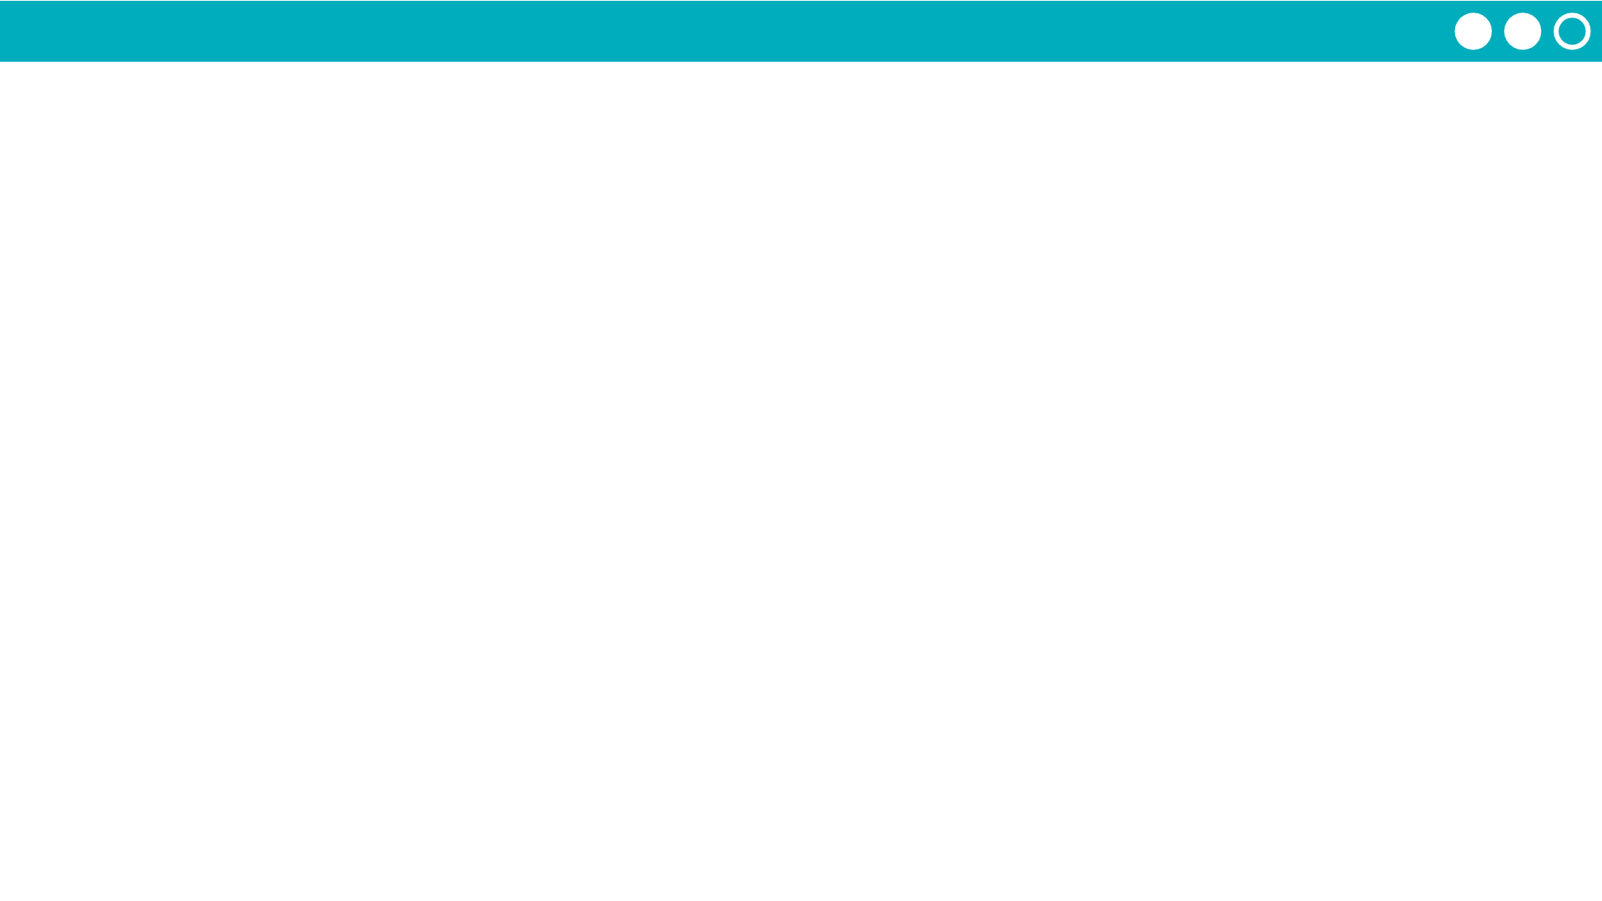
Unit 5 Lesson 11 - Activity
Debugging Lists
Use console.log to track lists in the Debug Console. Click the arrow to see elements listed by index. Don’t forget the last index is length-1
Add the list to the Watcher panel to track changes to the list as the app runs. The Watcher also shows the length of the list.

