Slide 1
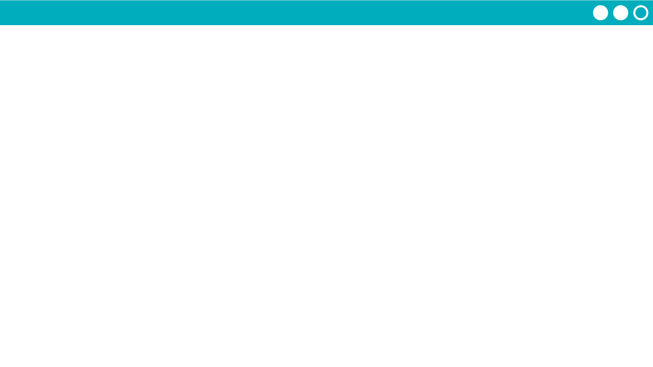
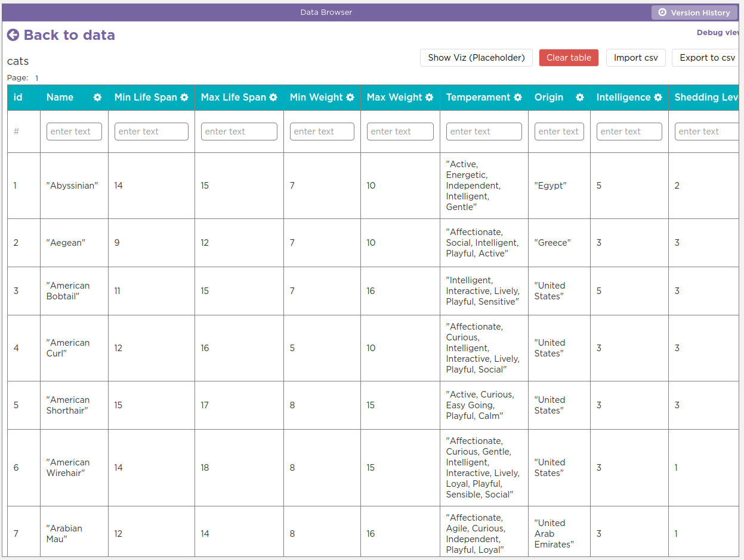
Unit 5 Lesson 11 - Activity
Debugging and the Data Tab
Go actually look at your data!
Use console.log to make sure you’re actually getting the information you want from your tables

