Slide 1
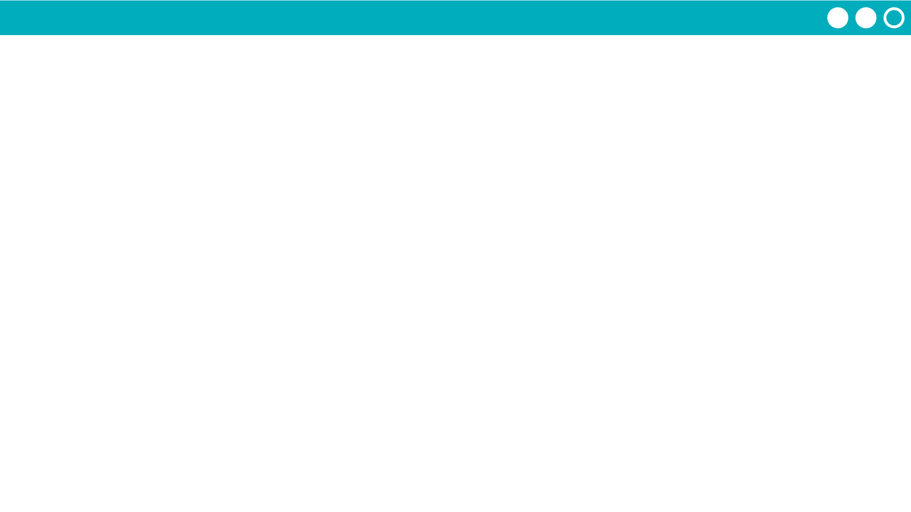
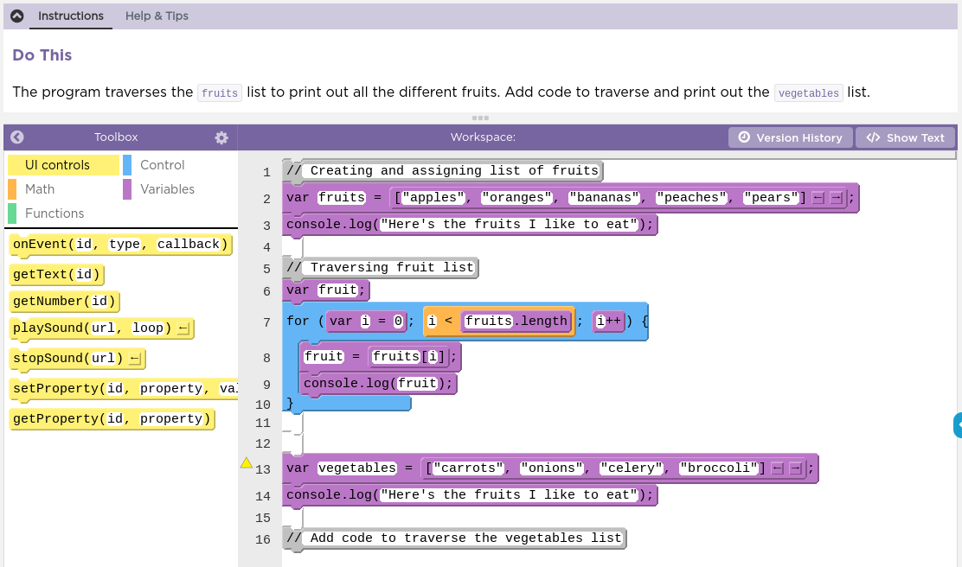

Unit 5 Lesson 11 - Activity
Traversals Practice
Do This:
Navigate to Lesson 11, Level 1 on Code Studio

