Slide 1
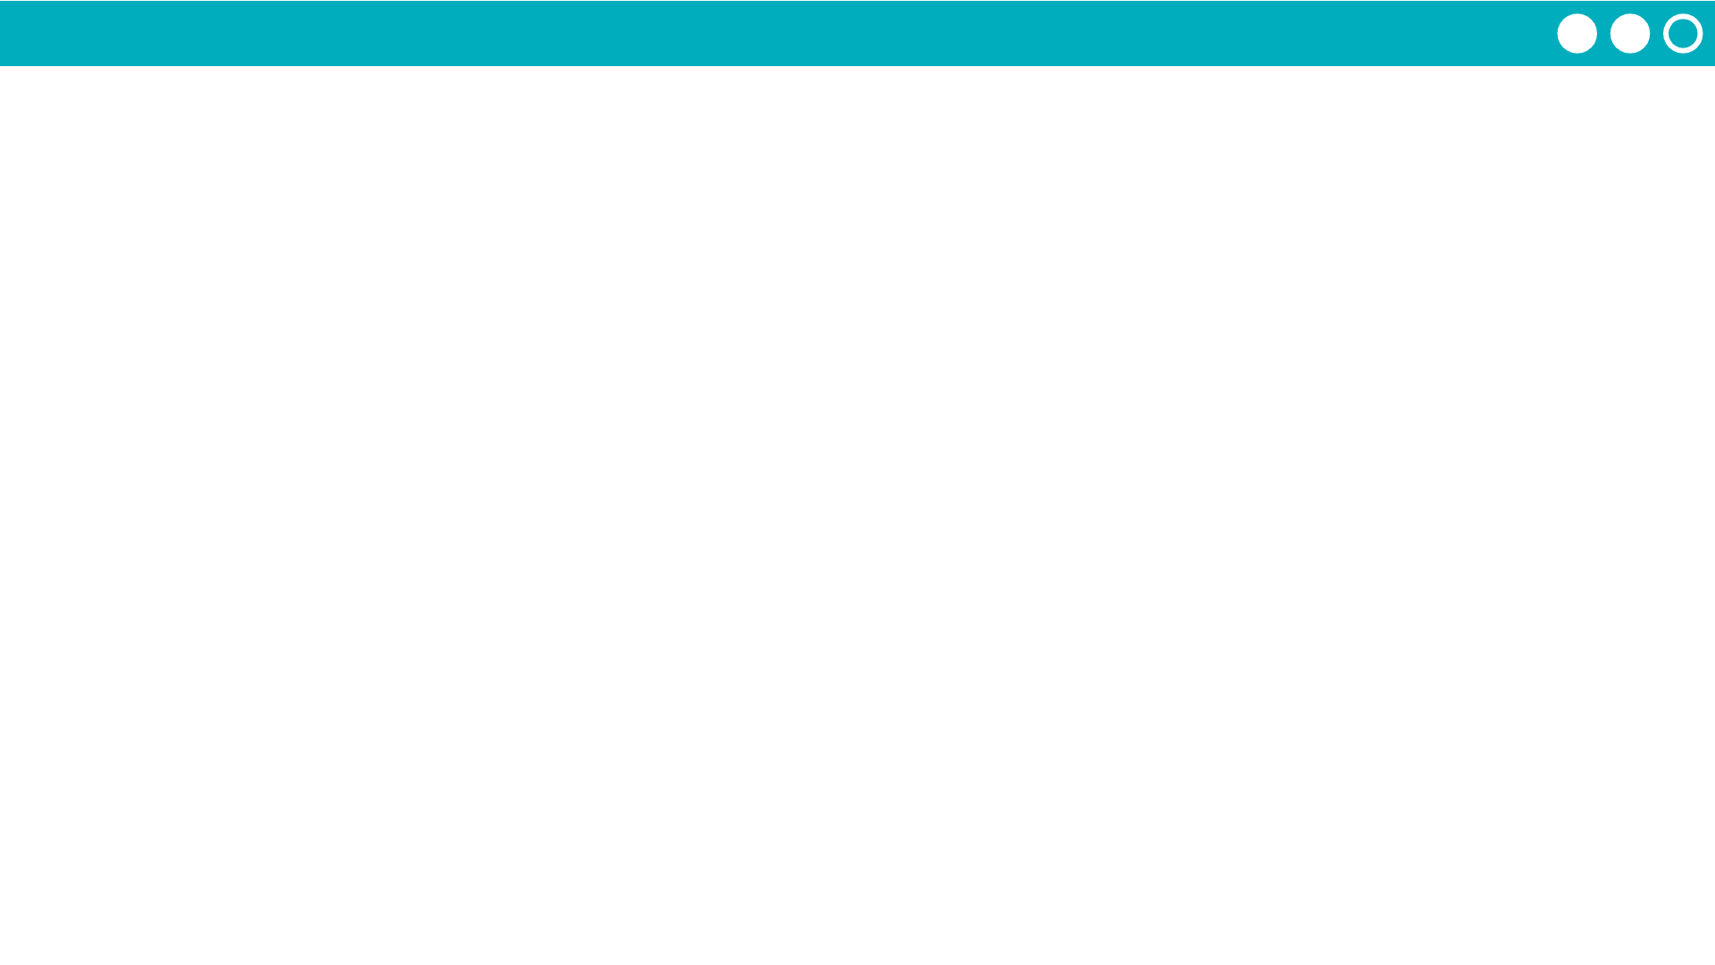
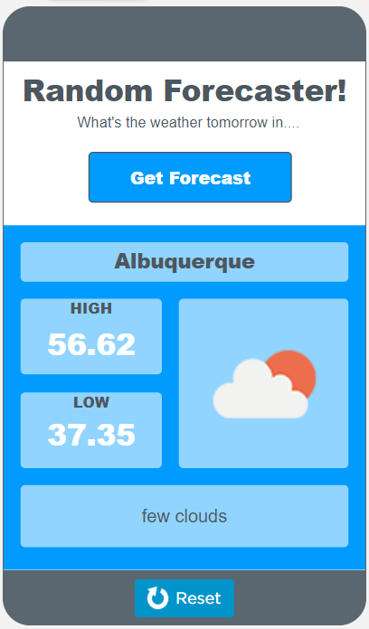

Unit 5 Lesson 12 - Activity
Traversals Make:
Random Forecaster
Do This:
Navigate to Lesson 12, Level 1 on Code Studio

