Slide 1
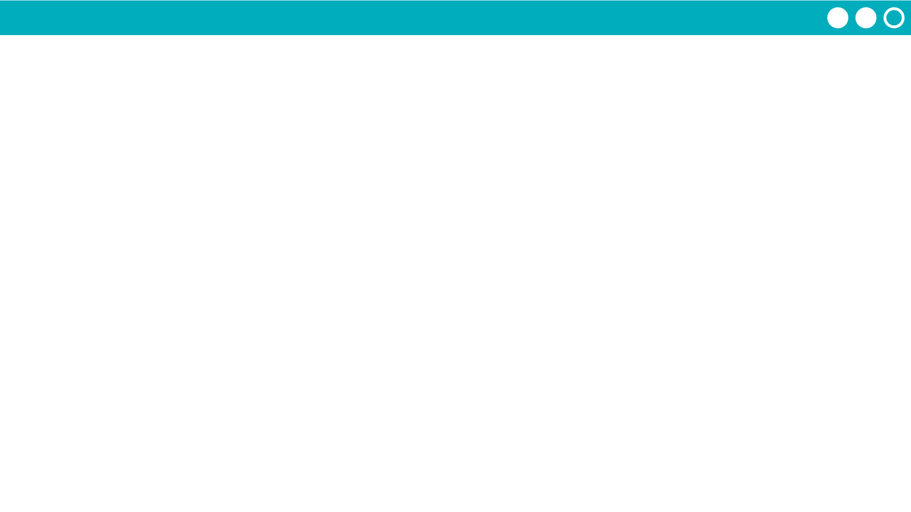
Unit 5 Lesson 12 - Activity
Do This:
Click on "Get Forecast".
Click the button several times to see how the display changes.
Prompts:
What information is needed to create this app?
What list filtering patterns might be used?

