Slide 1
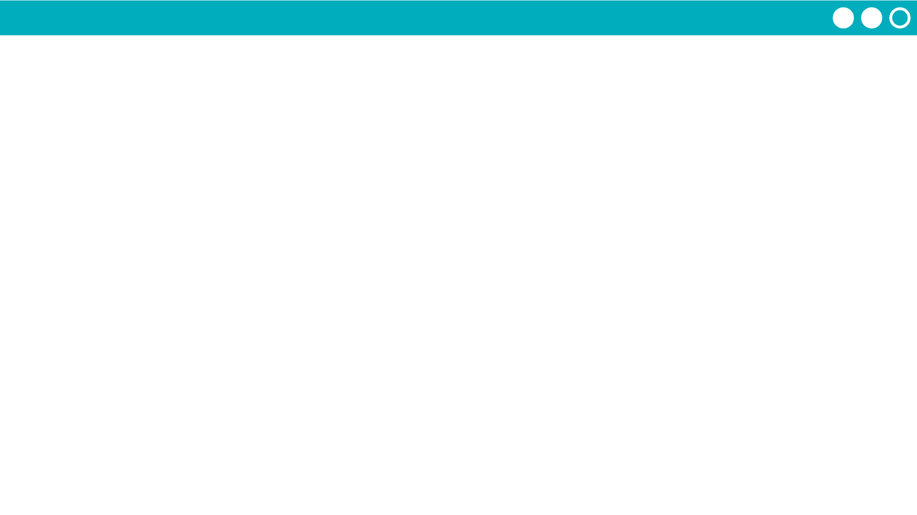
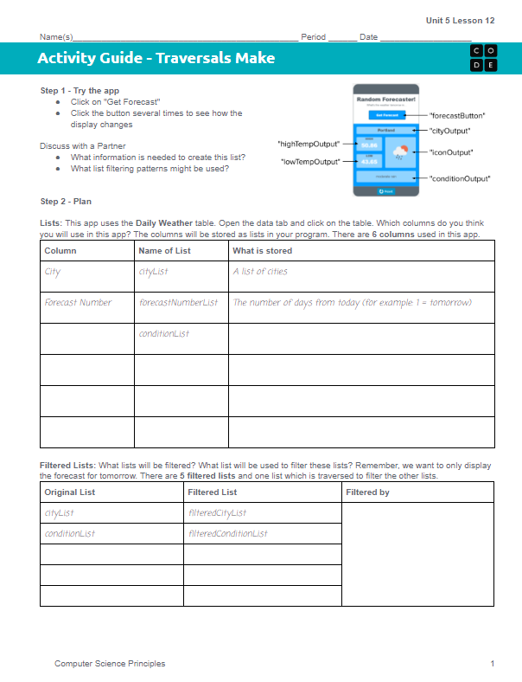
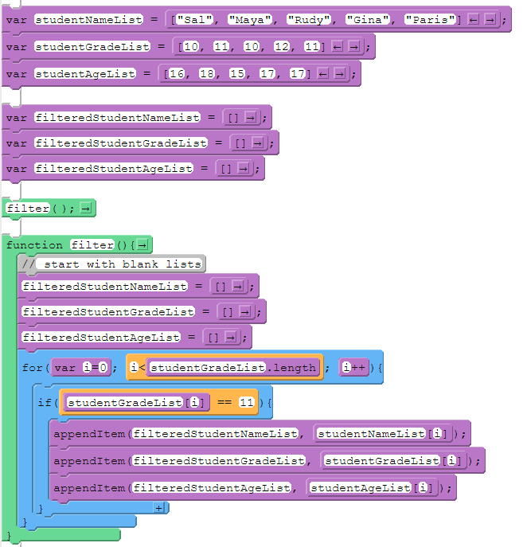
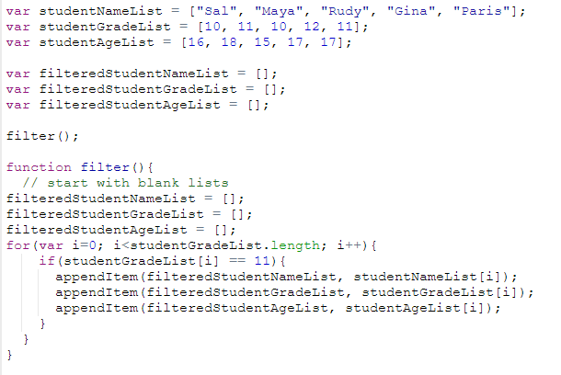
Unit 5 Lesson 12 - Activity
Do This: Make the Random Forecaster App!
The List Filter Pattern: Filtering Multiple Lists

