Slide 1
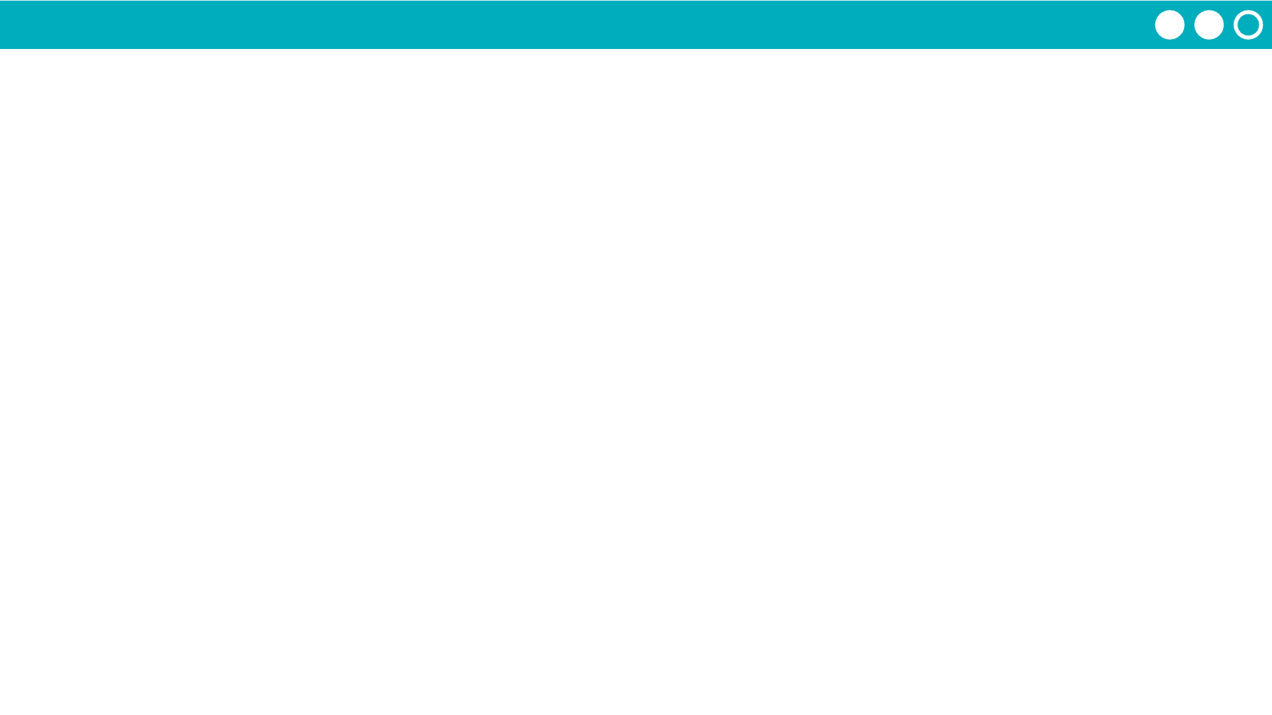
Unit 5 Lesson 13 - Activity
Project Description
For this project you will work with a partner. Together you will create an app that uses a dataset. There are two roles in this project: designer and programmer. You are both responsible for the overall project, but you will focus on different parts of the project at any given time. On the last day of the project, you will individually complete a written response that will help you practice for the Create Performance Task.
You will submit
Your final app
This completed project-planning guide
A written response
App Requirements
At least three screens
All screens can be easily navigated to through the user interface
A dataset used in a meaningful way towards the programs purpose
At least one list is traversed using: map, reduce, or filter (indicate which in a comment) in a meaningful way towards the program's purpose
Programming constructs: variable(s), function(s), conditional(s), list(s), loop(s)
All functions include comments that explain their purpose and how they work
All element IDs have meaningful names
No errors in the code

