Slide 1

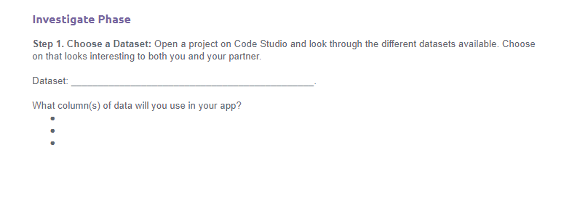
Unit 5 Lesson 13 - Activity
Hackathon Project
Step 1: Choose a Dataset: With a partner...
Go to the Make Project you just finished. Open up the data tab and look a the datasets.
Choose a dataset that looks interesting to you
Fill out the bottom of Page 1 in the Planning Guide.

