Slide 1

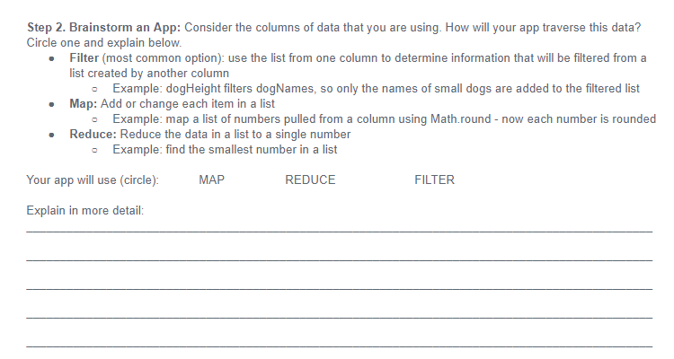
Unit 5 Lesson 13 - Activity
Hackathon Project
Step 2: Brainstorm an App: With a partner...
Consider the columns of data that you are using. How will your app traverse this data?
Filter (most common option): use the list from one column to determine information that will be filtered from a list created by another column
Example: dogHeight filters dogNames, so only the names of small dogs are added to the filtered list
Map: Add or change each item in a list
Example: map a list of numbers pulled from a column using Math.round - now each number is rounded
Reduce: Reduce the data in a list to a single number
Example: find the smallest number in a list
Complete in Planning Guide.

