Slide 1

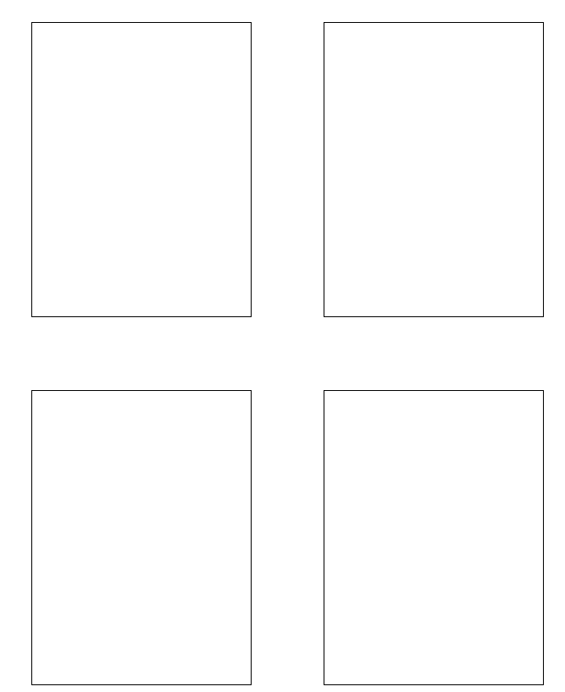
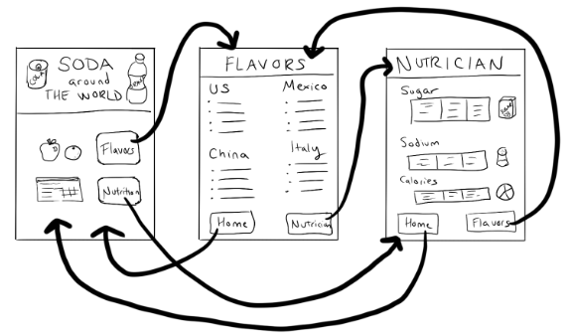
Unit 5 Lesson 13 - Activity
Hackathon Project
Step 3: Create a paper prototype: With a partner…
Draw a prototype which shows how your app will actually run.
Include all the buttons, text, and images that the user will be able to use and see.
Write notes or draw arrows showing how different user interface elements should work. For example, if clicking a button takes me to another screen, I should draw an arrow from that button to the drawing of the screen.

