Slide 1

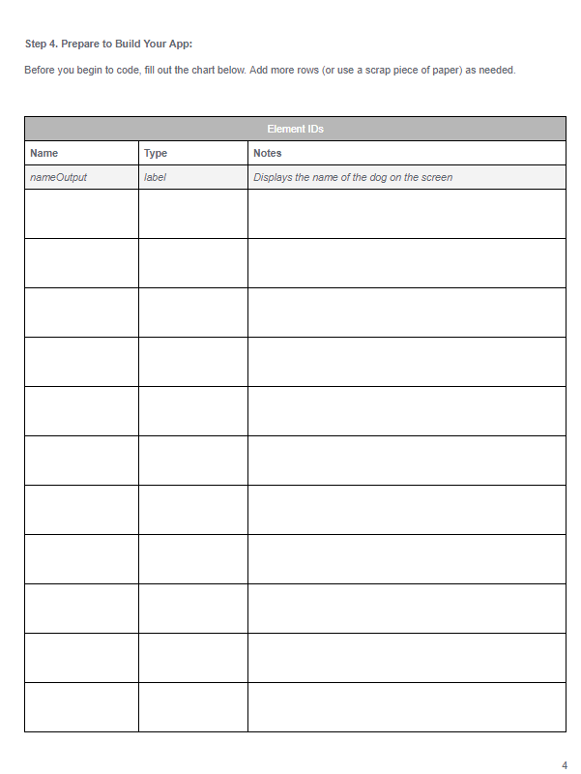
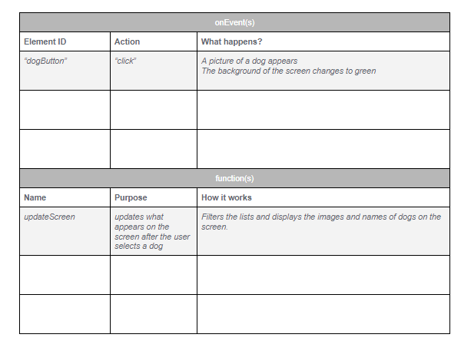
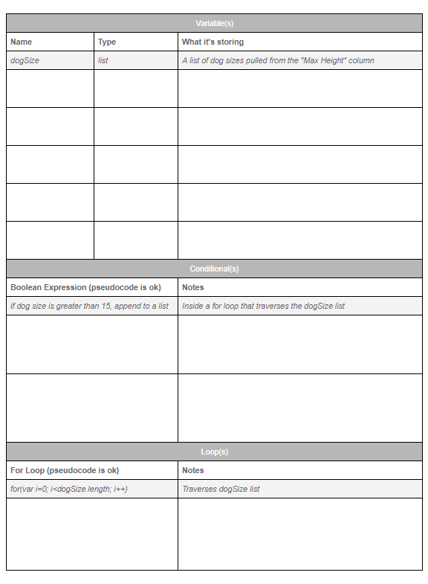
Unit 5 Lesson 14 - Activity
Hackathon Project
Step 4: Prepare to Build Your App: With a partner...
Fill out the tables on pages 4-6 of the Planning Guide

