Slide 1
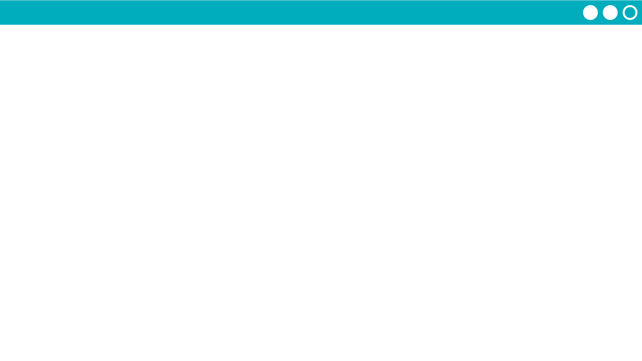
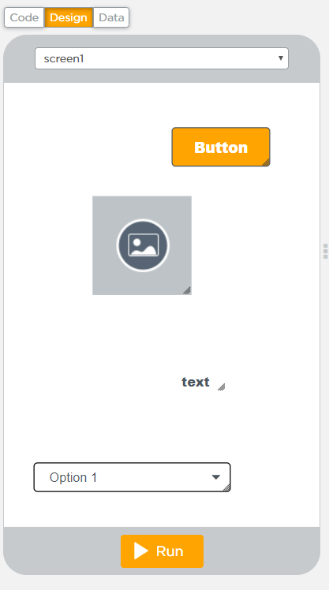
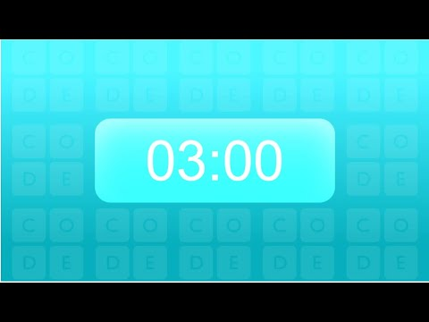
Unit 5 Lesson 14 - Activity
Hackathon Project
Step 5: Test Screens: With a partner...
Build a quick version of the screens which includes all elements with their proper element IDs. Do not worry about design at all. This is purely to allow the programmer the ability to test their code as they go along.

