Slide 1
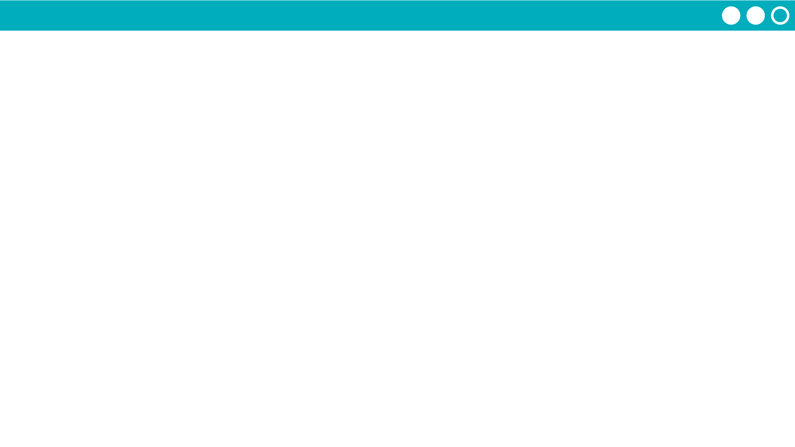
Unit 5 Lesson 14 - Activity
Designer, ready to share your screens with the programmer? Follow the steps below.
Why is this step necessary?
It's a little complicated. You cannot delete all of the screens from a project. In order to get rid of the old project screens, you'll need a new temporary screen. Once you've imported the Designer's screens, you can get rid of this temporary screen.
Designer
Programmer
Programmer - Add a blank screen.
Programmer - Delete the old project screens (the placeholders).
Programmer - Click the screen dropdown, then click "Import screen"
Designer - Click to share your project. Copy the link and send to the Programmer.
Programmer - Paste in the link from the Designer.
Programmer - Select to import all of the screens.
Delete the blank screen.
Set the home screen to be the default screen (Hint: Go to design mode and click on the screen)
Why do I need to delete before importing?
The Programmer and Designer will have used the same element IDs for the placeholder screens and the imported screens. This may lead to problems when importing if the placeholder screens are not deleted first.

